Slide 1
Critical Infrastructure Security: Mitigating Cyber Threats in Smart Grid
Daisuke Mashima
Illinois at Singapore Pte Ltd
Advanced Digital Sciences Center
March 12, 2019
at
IBC Smart Energy Summit 2019
Version 2, WGT

Slide 2
Brief Bio
01
Daisuke MASHIMA, PhD
Experience
Senior Research Scientist at ADSC and Research Affiliate at University of Illinois at Urbana Champaign
2 government-funded smart grid security projects
Formerly research scientist at Fujitsu Laboratories of America
Smart energy and smart home IoT systems
Security and privacy in smart metering
OpenADR2.0 standardization
Education
PhD in Computer Science from Georgia Tech in 2012
Security and privacy in Electronic Healthcare Records
Others
Cybersecurity and Privacy Symposium co-chair at IEEE SmartGridComm 2019
Best paper award from IEEE SmartGridComm 2014
President Awards and Standardization Promotion Award from Fujitsu

Slide 3
Outline
01
Brief Bio
01
Award
Experience
Education
Cyber Threats in Smart Grid Infrastructure
02
Smart grid overview
Security threats in smart grid
Measures for Securing Smart Grid Systems
03
IEC 62351
Intrusion detection systems
Bump-in-the-wire security
State-of-the-art security scheme from ADSC
04
SCADA command authentication
Smart grid honeypot
Concluding Remark
05

Slide 4
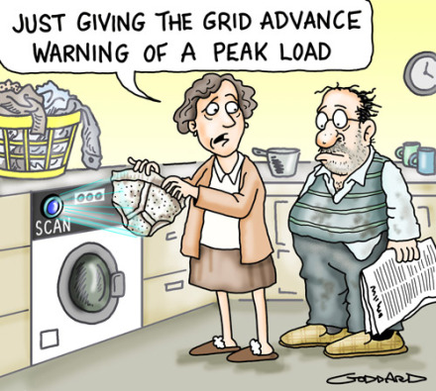
What is Smart Grid?
02
Power grid enhanced with ICT (information and communication technologies)
Reliability
Efficiency
Security
Safety
https://alittlefridaystory.com/2016/01/22/solar-power-a-new-hope/

Slide 5
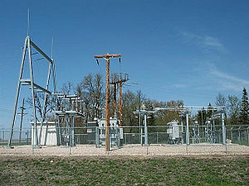
Modernization of Electrical Substations
02
Crucial component of power grid system for delivery of electricity (e.g., voltage transformation)
Over 10,000 substations in Singapore
Remotely managed or controlled for load/power shedding, voltage regulation, and topology control
https://en.wikipedia.org/wiki/Electrical_substation

Slide 6
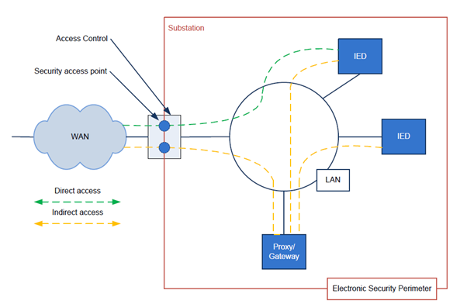
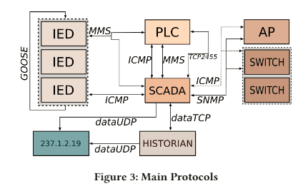
Modernization of Electrical Substations
02
Adoption of standard technologies such as IEC 60870-5-104 (or IEC104) or DNP3 and IEC 61850 for remote control and automation
IEC61850
(MMS/GOOSE)
IEC104
Protocols used in EPIC smart grid testbed
IEC 61850-90-2 TR: Communication networks and systems for power utility automation –
Part 90-2: Using IEC 61850 for the communication between substations and control centres - Page 10
Ahnaf Siddiqi, Nils Ole Tippenhauer, Daisuke Mashima, and Binbin Chen, "On Practical Threat Scenario Testing in an Electric Power ICS Testbed." In Proc. of the 4th ACM Cyber-Physical System Security Workshop (ACM CPSS 2018).

Slide 7
Security by “Air Gap.” Myth or Truth?
02
Isolation from other systems or external network
Dedicated communication infrastructure
All devices were trusted.
Security was not part of protocol or system design.
https://www.belden.com/blog/industrial-security/goodbye-air-gaps-hello-improved-ics-security

Slide 8
Stuxnet Worm
02
Targeted nuclear plants in Iran
Exploited multiple zero-day vulnerabilities on Windows
Can infect via USB drive
Successfully compromised PLC connected to centrifuge units
(null-byte.wonderhowto.com)

Slide 9
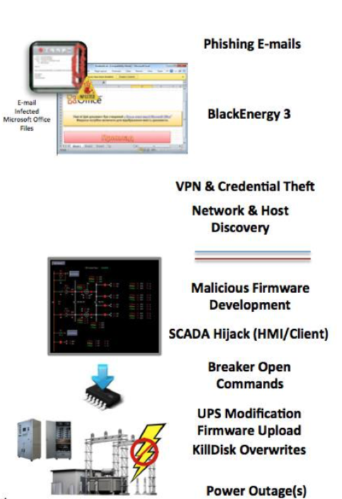
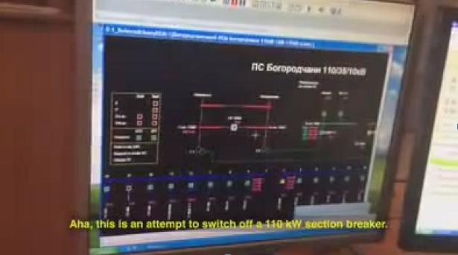
Ukraine Power Plant Attacks
02
Caused massive power outage in Ukraine
Ironically demonstrated “ICS Cyber Kill Chain”
Ironically demonstrated “ICS Cyber Kill Chain”
(https://www.youtube.com/watch?v=8ThgK1WXUgk)
(https://ics.sans.org/media/E-ISAC_SANS_Ukraine_DUC_5.pdf)

Slide 10
CrashOverride/Industroyer
02
‘Reported in the Ukraine incident in 2016
‘Abuses widely-used ICS protocols, including １IEC 60870-5-104 and IEC 61850
‘Reported in the Ukraine incident in 2016
‘Abuses widely-used ICS protocols, including １IEC 60870-5-104 and IEC 61850
Capable of issuing valid SCADA commands
https://gigazine.net/news/20170613-crashoverride/

Slide 11
Aurora Generator Test
02
Conducted by Idaho National Lab in 2007
Demonstrated how a cyber-originated attack can damage physical power grid components.
Succeeded in exploding a diesel generator in 3 minutes!
https://en.wikipedia.org/wiki/Aurora_Generator_Test

Slide 12
Outline
01
Brief Bio
01
Award
Experience
Education
Cyber Threats in Smart Grid Infrastructure
02
Smart grid overview
Security threats in smart grid
Measures for Securing Smart Grid Systems
03
IEC 62351
Intrusion detection systems
Bump-in-the-wire security
State-of-the-art security scheme from ADSC
04
SCADA command authentication
Smart grid honeypot
Concluding Remark
05

Slide 13
IEC 62351 Standards
03
Define security specifications for smart grid communication protocols
IEC 60870-5-104, IEC 61850, DNP3, etc.
Heng Chuan Tan, Carmen Cheh, Binbin Chen, and Daisuke Mashima, “Tabulating Cybersecurity Solutions for Substations: Towards Pragmatic Design and Planning.” Under submission.

Slide 14
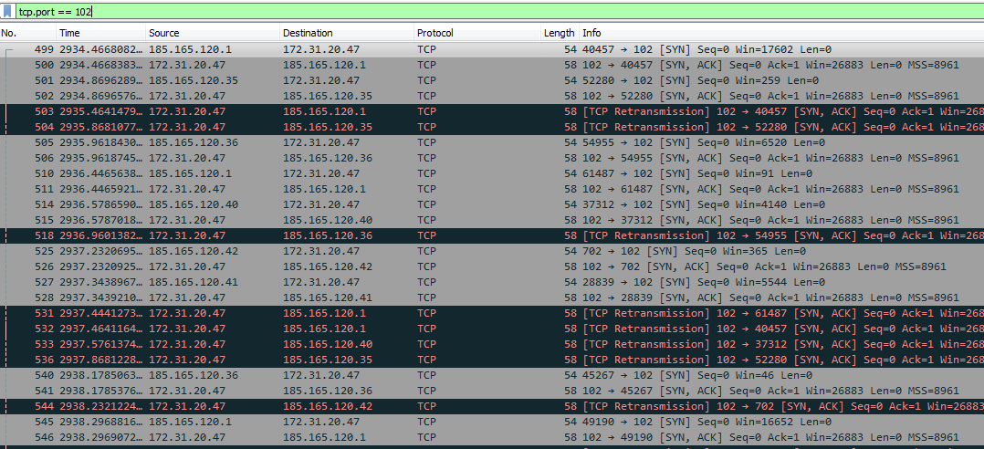
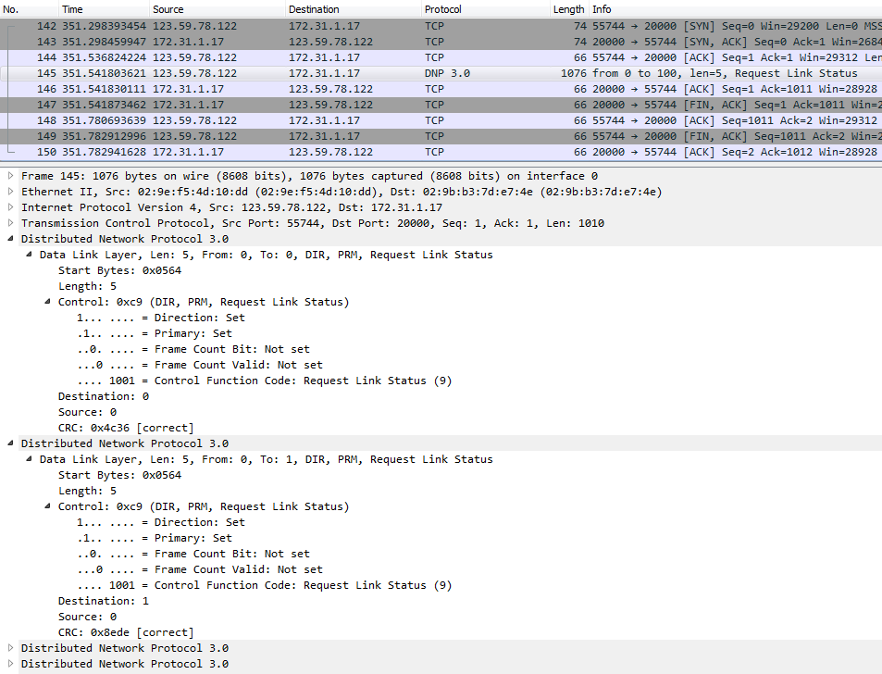
Intrusion Detection Systems
03
Detect malicious/anomalous events in the system
Network-based IDS is popular in the ICS domain.
DoS (SYN-flood) attack against IEC 61850 MMS
Signature-based IDS
Based on “known” attack patterns
Anomaly-based IDS
Statistics-based
Machine-learning-based
Physics-based IDS
Power-system physical laws (e.g., state estimation)
Ensemble IDS
Scanning against DNP3

Slide 15
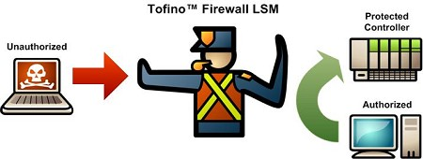
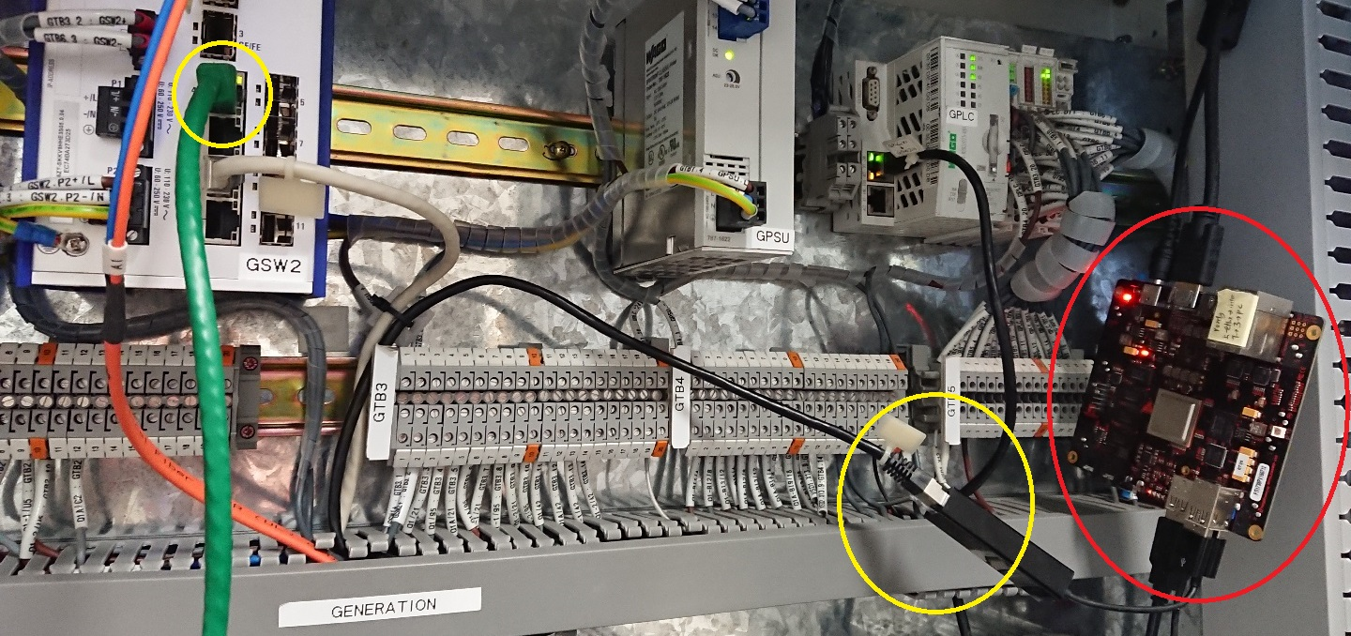
Bump-in-the-wire Solutions
03
Introduce devices to provide security features in add-on manner
Network traffic control with firewall and data diode
https://www.tofinosecurity.com/products/Tofino-Firewall-LSM
https://www.stengg.com/en/electronics/companies-affiliates/st-electronics-info-security/digisafe-data-diode-solution/
Enhanced message authentication
Add bump-in-the-wire (BITW) devices that handle cryptographic protocols in a transparent manner
BITW device integrated into EPIC Testbed

Slide 16
Outline
01
Brief Bio
01
Award
Experience
Education
Cyber Threats in Smart Grid Infrastructure
02
Smart grid overview
Security threats in smart grid
Measures for Securing Smart Grid Systems
03
IEC 62351
Intrusion detection systems
Bump-in-the-wire security
State-of-the-art security scheme from ADSC
04
SCADA command authentication
Smart grid honeypot
Concluding Remark
05

Slide 17
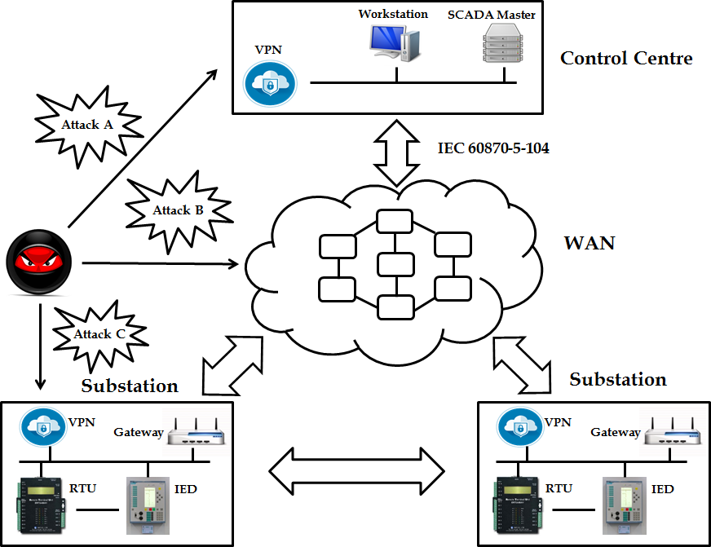
Need for Additional Lines of Defense
04
Authentication
Access Control
Security Patch
Anti-virus
Firewall
Data diode
Intrusion Detection
IEC 62351
Etc.
Substation
No longer fully effective once a trusted entity becomes malicious!

Slide 18
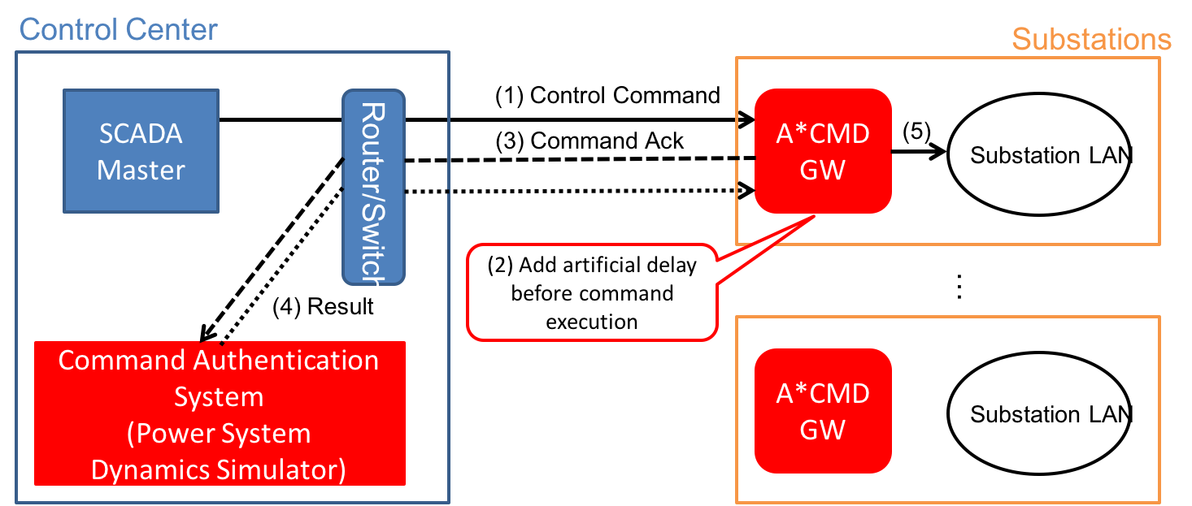
SCADA Command Authentication
04
Deployed at (near) the edge of cyber infrastructure
Reliably mediate incoming remote control commands
Evaluate legitimacy / validity of the commands before execution
A*CMD stands for Active Command Mediation Defense.
Daisuke Mashima, Prageeth Gunathilaka, and Binbin Chen, "An Active Command Mediation Approach for Securing Remote Control Interface of Substations."
In Proc. of IEEE SmartGridComm 2016 in November, 2016.
Daisuke Mashima, Prageeth Gunathilaka, and Binbin Chen, “Artificial Command-delaying for Securing Substation Remote Control: Design and Implementation." In press for IEEE Transactions on Smart Grid.
Daisuke Mashima, Binbin Chen, Toby Zhou, Ramkumar Rajendran, and Biplab Sikdar, “Securing Substations through Command Authentication Using On-the-fly Simulation of Power System Dynamics.” In Proc. of IEEE SmartGridComm 2018.
Daisuke Mashima, Ramkumar Rajendran, Toby Zhou, Binbin Chen, and Biplab Sikdar, “On Optimization of Command-Delaying for Advanced Command Authentication in Smart Grid Systems.” Under submission.

Slide 19
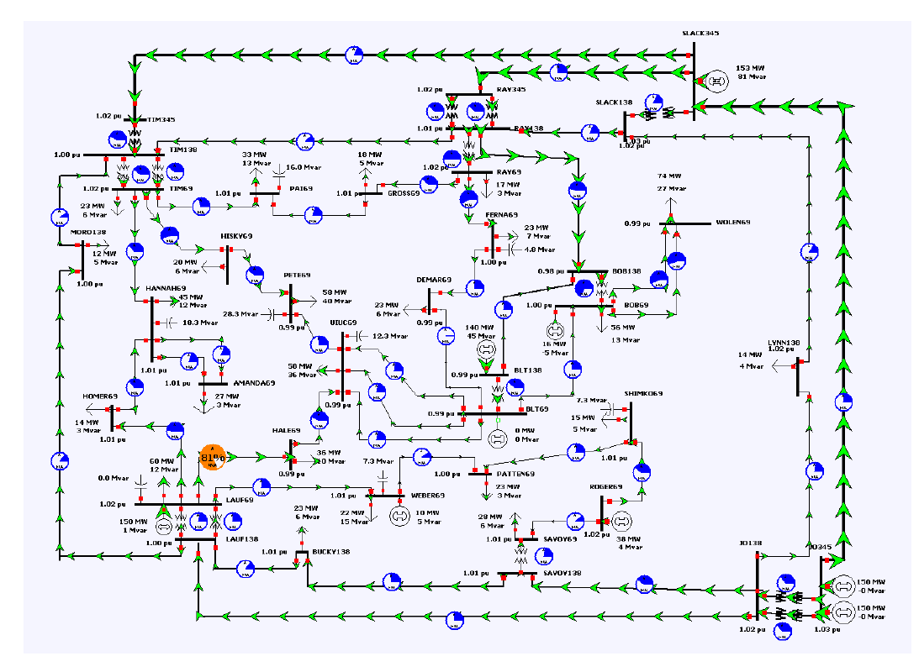
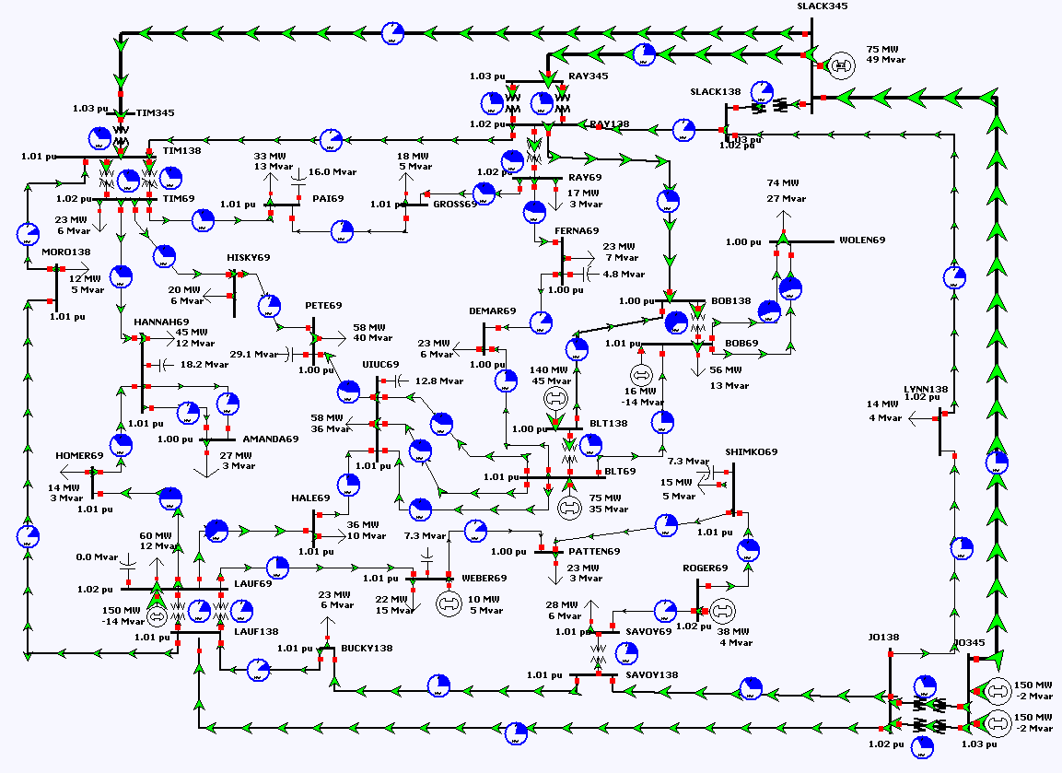
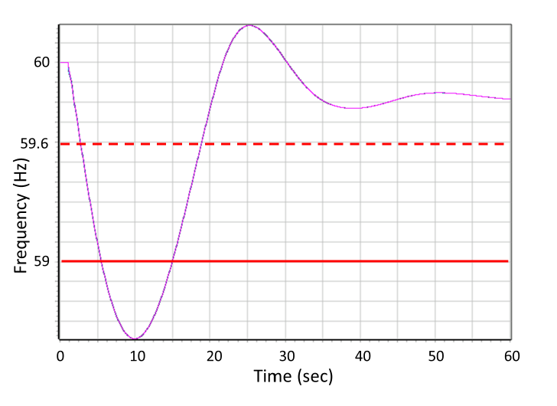
Command Authentication Based on Power System Dynamics Simulation
04
Steady-state power flow simulation
Employed by many state-of-the-art schemes
Fast to calculate
Provides only limited information
0
Power system dynamics simulation
Transient-state behavior (e.g., frequency change) as well as cascading events
Nominal Freq.
Frequency violation in term of WECC Category C limit
(59Hz over 7 second)

Slide 20
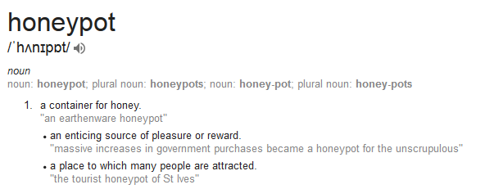
Honeypot for Smart Grid Systems
04
In cybersecurity domain, honeypot is a dummy system to attract attackers.
Should look like a valuable, real system
Intentionally exposed to attackers
Honeypot can be used to:
Collect threat intelligence
Buy time before actual attacks
Detect persistent attackers

Slide 21
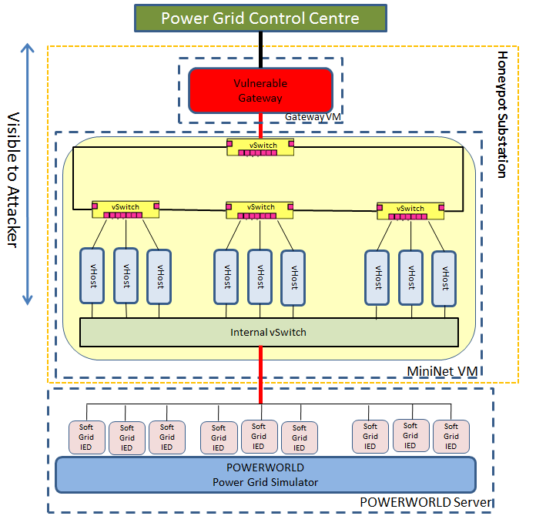
High-fidelity Substation Honeypot
04
Honeypot system for smart grid / ICS is not mature yet.
Lack of physical-system behavior
Integrate power system simulation for consistent, cyber-physical system view
Use system and network virtualization for realism and scalability
Implemented on top of SoftGrid (http://www.illinois.adsc.com.sg/softgrid/)
Funded by Singapore Cybersecurity Consortium for enhancement of realism and functionality (2018-)
https://sgcsc.sg/event-2018-09-seedgrant.html
Monitoring
(e.g., Wireshark)
Daisuke Mashima, Binbin Chen, Prageeth Gunathilaka, and Edwin Tjiong, “Towards a Grid-wide, High-fidelity electrical Substation Honeynet.” In Proc. of IEEE SmartGridComm 2017.

Slide 22
Outline
01
Brief Bio
01
Award
Experience
Education
Cyber Threats in Smart Grid Infrastructure
02
Smart grid overview
Security threats in smart grid
Measures for Securing Smart Grid Systems
03
IEC 62351
Intrusion detection systems
Bump-in-the-wire security
State-of-the-art security scheme from ADSC
04
SCADA command authentication
Smart grid honeypot
Concluding Remark
05

Slide 23
Concluding Remarks
05
Power grid is under cyber attack in reality!
Existing security measures are not enough to counter emerging cyber threats.
SCADA command authentication provides the last line of defense before attacks are reaching physical systems.
Substation honeypot is effective for collecting threat intelligence as well as for countering persistent attackers.
Power grid operators, industry, and academia should join force. Please feel free to contact us for any discussion, demonstration, collaboration opportunities!

Slide 24
Questions?
https://www.slideshare.net/RobertMLee1/a-child-like-approach-to-grid-cybersecurity
Web: https://adsc.illinois.edu
Email: daisuke.m@adsc-create.edu.sg

