Slide 1
Customer-centric Energy Usage Data Management and Sharing in Smart Grid Systems
Gaurav Lahoti
University of Illinois at Urbana-Champaign, IL, USA
Daisuke Mashima
Wei-Peng Chen
Fujitsu Laboratories of America Inc., USA

Slide 2
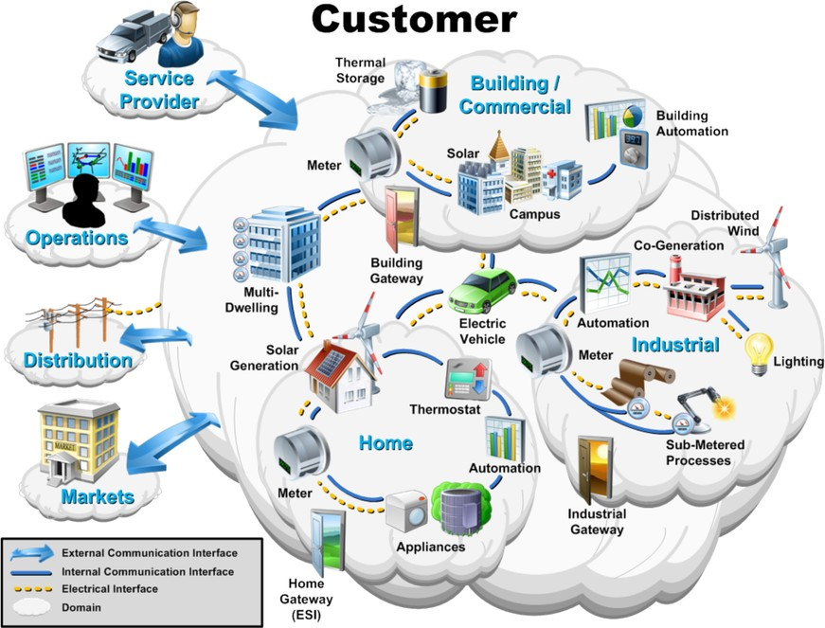
Smart Grid – Consumer Domain
Source: http://www.ietf.org/proceedings/77/slides/intarea-7.pdf

Slide 3
Smart Grid – Green Button
Green Button allows customers to download their energy usage information from electricity supplier in an easy-to-understand standard XML format
Source: http://www.greenbuttondata.org/

Slide 4
Power Usage Data - Services
The power usage data being available to customers has opened venues for 3rd party applications and specialized services
Analyzing energy usage and provide actionable tips
Measurement of energy-efficiency investments
Demand-Response (DR) Aggregation
It is an active area of research and new services are constantly emerging in the market

Slide 5
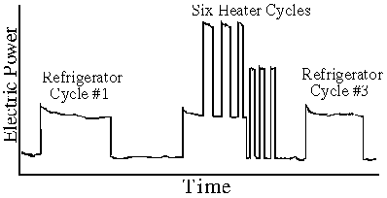
Privacy Risks
Non-intrusive Appliance Load Monitoring (NALM)
To infer information like devices used in the house, office timings, home presence pattern, usage time of specific devices, etc.
Sample NALM
Source: http://georgehart.com/research/nalm.html

Slide 6
Goals – Customer Centricity & Data Authenticity
Customers
Have full control over their energy usage data
Should be able to govern sharing of the data with third parties
Third Party
Should be able to ensure that the data provided by a customer is the actual data as collected and has not been modified
Utility
Should be unaware of how the energy usage data is being used by the customer

Slide 7
Customer-centric Energy Data Utilization
Utility
Signed Energy Usage Data
Repository
Redacted, Signed Energy Usage Data
Data Sharing, Redaction Request
Signed Energy Usage Data
Meter Reading
Third Party
Customer
Customer Domain

Slide 8
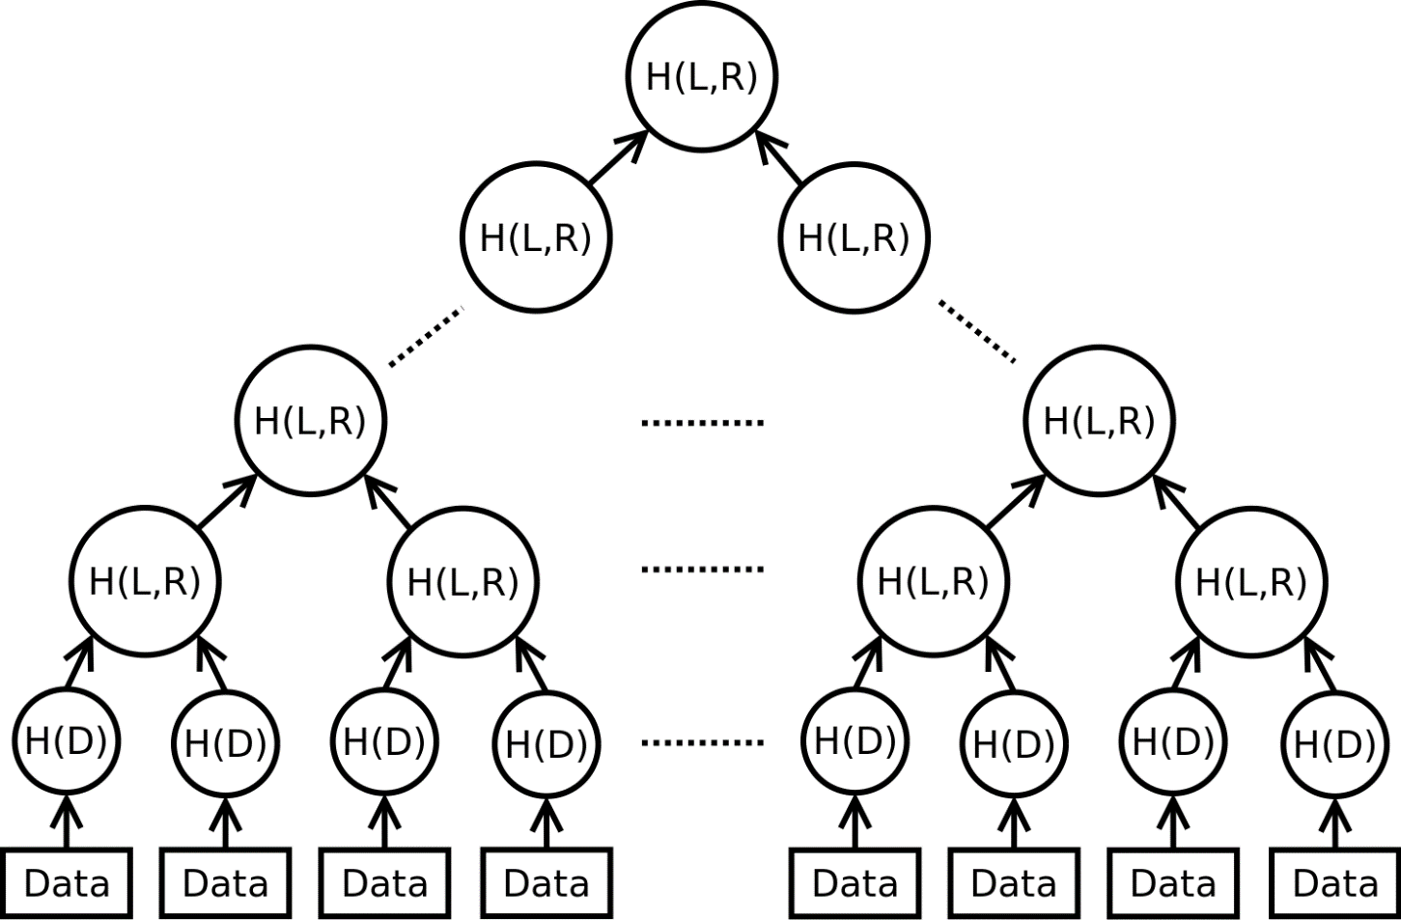
Redactable Digital Signature
Signed by Utility
Data replaced by a parent hash
Merkle Hash Tree

Slide 9
Brute Force Attack - I
Meter reading values have a limited small range with a small upper bound
An attacker can generate a table, mapping all possible plain text values (i.e. energy usage data) to their hash values
One table is enough for all the customers!
Keyed Hash using a Per-Customer Key
Allows for different hash values for different customers even when a meter reading value (or a series of values) are identical.
The key is shared with the utility company and third party to construct hash tree and calculate the root hash

Slide 10
Brute Force Attack - II
Key is per customer and it allows mapping of identical meter reading values to same hash values for one customer
A malicious entity can construct a meter reading to hash table for each customer as the search space is small
Random Initialization Vector (IV) and Counters
Ensures that no two same data values of the same customer result in the same hash value
One IV is generated for each data file
IV is incremented by 1 for each data block
$$Hk\left(D,IV,i\right)=M(D, \left(K⊕\left(IV+i\right)\right))$$
Hash Function for the leaf nodes

Slide 11
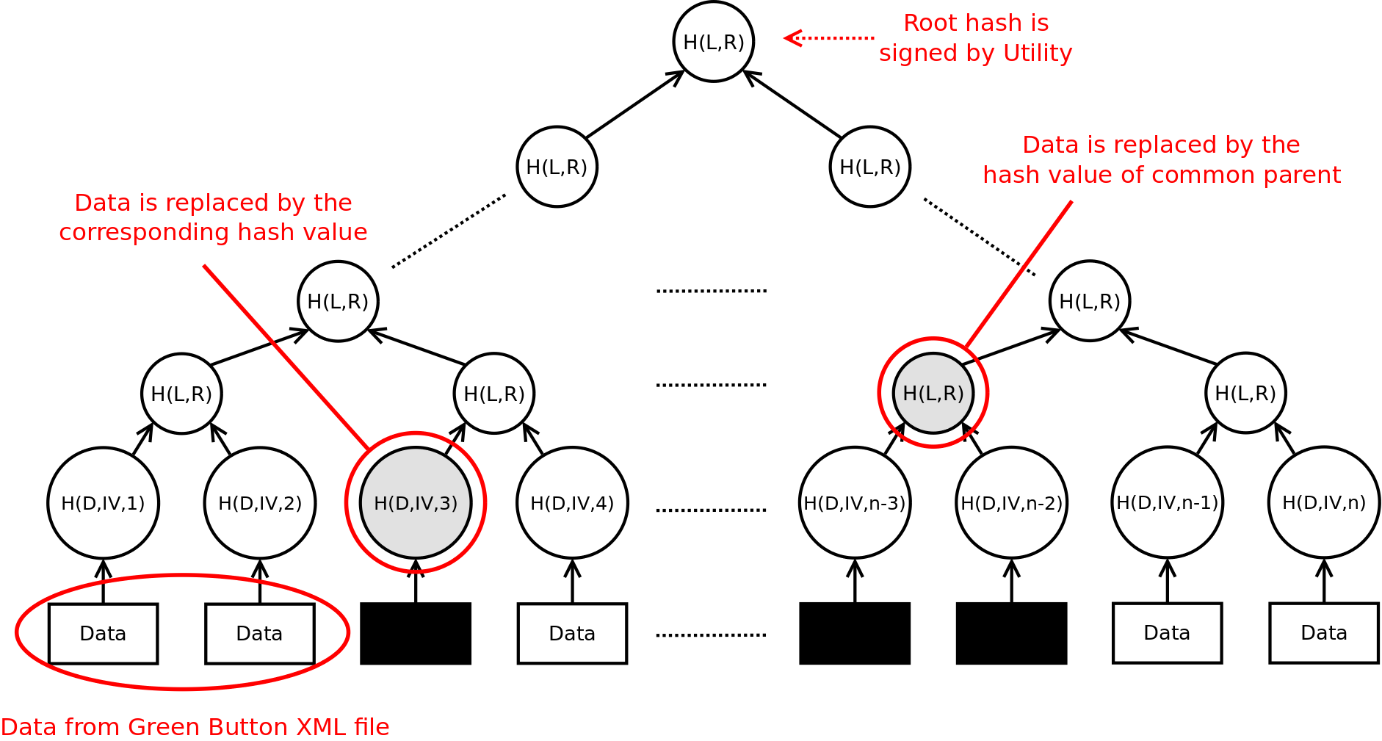
Verifiable Redaction of Energy Usage Data
Verifiable, Redactable Energy Usage Data based on Merkle Hash Tree

Slide 12
Security Analysis
A brute-forcing adversary will have to loop through the range of estimated data values for each hidden value
System is secure when a large number of contiguous data blocks are redacted
Under typical DR use case, only a few hours of data per day is disclosed and rest is redacted
Number of Redacted Data Blocks | Estimated Search Space Range | Number of Attempts Required
8 | 1000 | ~ 2⁸⁰
2 | 1000 | ~ 2²⁰

Slide 13
Modified Green Button Information Model
0..1
LocalTime Parameters
SignatureInformation
UsagePoint
1
ServiceCategory
HashInformation
0..*
MeterReading
0..*
IntervalBlock
0..*
ElectricPower UsageSummary
1
0..*
0..*
ReadingType
IntervalReading
IntervalHash
0..*
ElectricPower UsageSummaryHash
0..*
0..*
ElectricPower QualitySummary
ReadingQuality

Slide 14
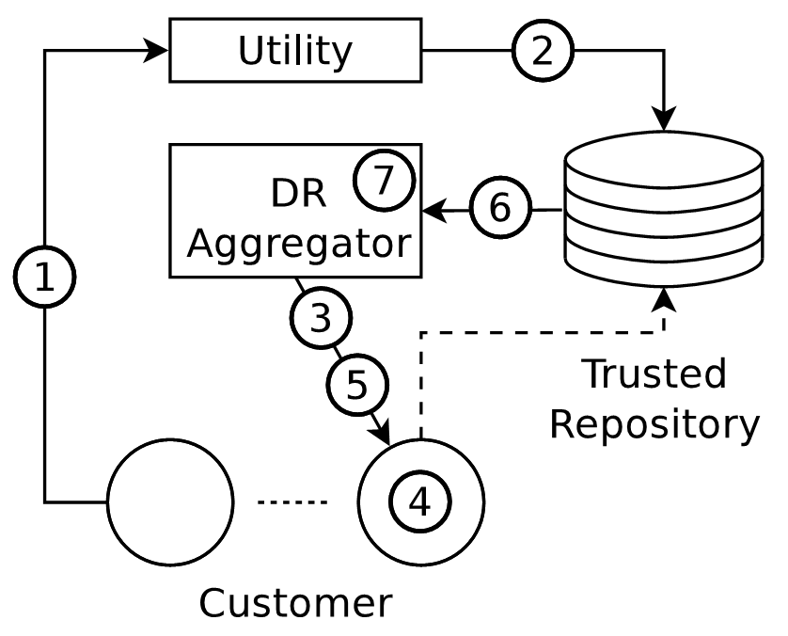
Application for Demand-response Aggregation Service
Energy usage data is reported to utility by smart meters (e.g., every 15 min)
Data collected by utility is downloaded and stored on the trusted repository
DR event is announced
DR event is executed
Usage data is requested
Customer selects which data it wants to disclose and sends redacted data
Aggregator verifies the data and evaluates customer’s performance

Slide 15
Summary
Customer-centric framework for energy usage data sharing
Merkle hash tree based design for redactable, verifiable energy usage data
Prototype implementation, extending Green Button data model
Future work – Proposal for standardization in Green Button

Slide 16
Thank You
Questions ?
For any queries, contact:
Gaurav Lahoti (lahoti2@Illinois.edu)
Daisuke Mashima (dmashima@us.fujitsu.com)

