Slide 1
OpenADR 2.0 Deployment Architectures: Options and Implications
Ulrich Herberg(*), Daisuke Mashima,
Jorjeta G. Jetcheva, and Sanam Mirzazad-Barijough
Fujitsu Laboratories of America, Inc.
(* Currently with Panasonic)

Slide 2










Motivation
Due to increasing peak demands, peak electricity prices, and integration of renewable energy, interest in automated demand response technologies is increasing globally.
OpenADR 2.0: Internationally-recognized, and the most widely adopted standard for automated demand response
  The latest 2.0b profile was just released in Aug., 2013.
  IEC approved OpenADR 2.0b as IEC/PAS 62746-10-1 in Feb., 2014
Defines only communication model between DR servers and clients
  Proliferation of proposed deployment architectures in vendor community!
  Compliance, scalability, and security implications are often not easy-to-understand.
http://www.openadr.org
etc.
1
Copyright 2014 Fujitsu Laboratories of America

Slide 3
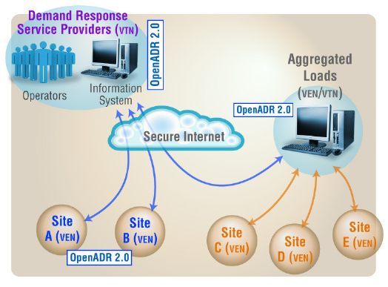
OpenADR 2.0 Overview
http://www.openadr.org
Message schema and communication model between VTN (Virtual Top Node) and VEN (Virtual End Node)
HTTP(PUSH/PULL) and XMPP(PUSH) as transport mechanisms
TLS 1.2 with client authentication (VENs are authenticated using their certificates) along with optional use of XML Signature
2
Copyright 2014 Fujitsu Laboratories of America

Slide 4
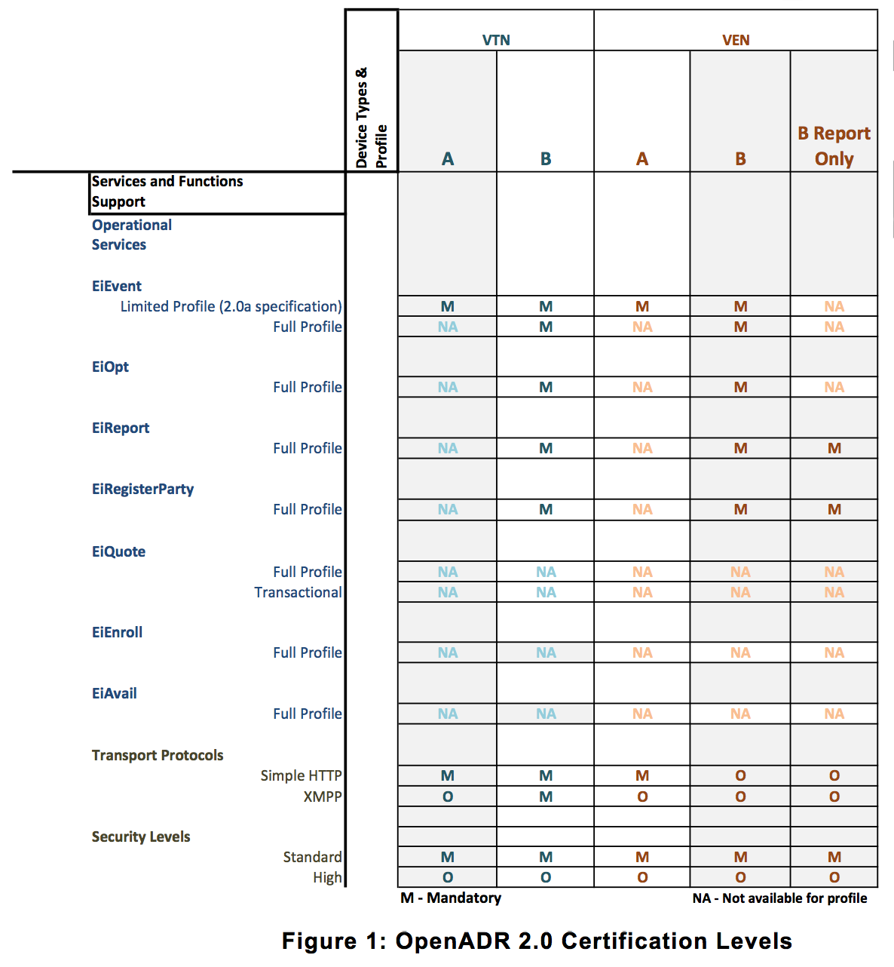
Services for Automated Demand Response
EiEvent service
  Distribute Demand Response Events to VENs
EiReport service
  Report electricity usage and/or resource status
EiRegisterParty service
  Register VEN to VTN
EiOpt service
  Inform availability for DR participation
http://www.openadr.org
3
Copyright 2014 Fujitsu Laboratories of America

Slide 5
Basic Two-tier Architecture
VEN
DR server
Resource
VTN
VEN
Resource
…
VEN
DR Participant
Strict end-to-end security guarantee
Complete visibility of all VENs
Scalability challenge!
4
Copyright 2014 Fujitsu Laboratories of America

Slide 6
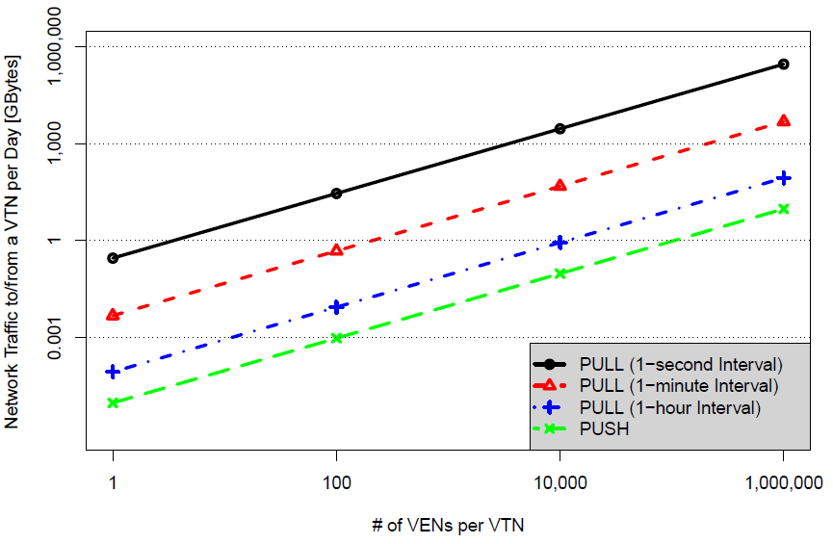
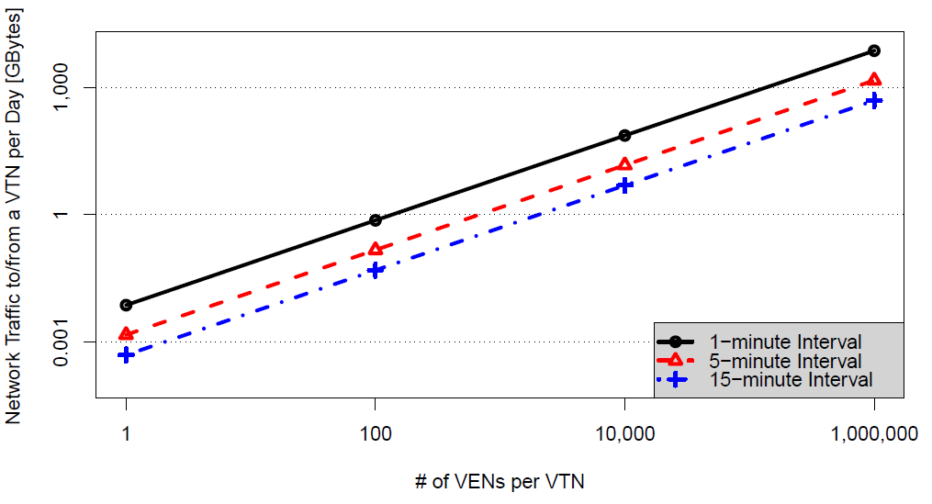
Basic Two-tier Architecture (Contd.)
EiEvent:
Assume 1 Demand Response event a day, which contains minimal parameters
EiReport:
Assume periodic telemetry report, each of which contains one meter reading value
5
Copyright 2014 Fujitsu Laboratories of America

Slide 7
Two-tier Architecture with XMPP
VEN
DR server
Resource
VTN
XMPP
Server
VEN
Resource
…
VEN
Some of the overheads of VTN, such as TLS handshake, can be off-loaded to XMPP Server
Need additional consideration to maintain end-to-end security
6
Copyright 2014 Fujitsu Laboratories of America

Slide 8
Basic Three-tier Architecture
VEN
VEN
Resource
VTN
VEN
VTN
VEN
Resource
…
…
DR Aggregator
VEN
VEN
Thanks to tree-like topology, VTN’s overhead can be reduced.
End-to-end security, visibility of lower tier VENs, and interoperability may be an issue.
7
Copyright 2014 Fujitsu Laboratories of America

Slide 9
Vendor Cloud Model
X
Vendor 1
VEN
Thermostat
Thermostat
Customer 1
Lighting
VTN
Vendor 2
VEN
Thermostat
Thermostat
Customer 2
Lighting
VTN needs to manage one VEN per device vendor, which provides scalability and complexity advantage
Segmented control by multiple vendors
Vendor lock-in and availability problem
8
Copyright 2014 Fujitsu Laboratories of America

Slide 10

VEN Application Server Architecture
VEN 1
VEN
Application
Server
Resource
VTN
To VEN1
VEN 2
Resource
…
VEN n
VEN 1
Customer’s Facility
Beneficial for customers with multiple VENs, in terms of cost and flexibility
Potential security issue owing to lack of one-to-one mapping between certificate and VEN
Compliance to the OpenADR spec is questionable.
9
Copyright 2014 Fujitsu Laboratories of America

Slide 11
XMPP Server-to-Server Architecture
VEN
DR server
Resource
X
X
VTN
XMPP
Server
External
XMPP
Server
VEN
Resource
…
X
VEN
VEN
Scalability advantage
External XMPP Server has to be fully trusted, which may not be practically possible
Revocation of External XMPP Server may cause service outage for a large number of VENs
10
Copyright 2014 Fujitsu Laboratories of America

Slide 12
Conclusions
Discussed representative OpenADR deployment architectures discussed or proposed in vendor community in terms of interoperability, scalability, complexity, and security
Highlighted potential issues to be considered when utilities and other DR service providers plan OpenADR deployment
  Will assist informed decision of ADR providers towards high-performance, future-proof, secure DR services
Future work will include experiments for each architecture to provide quantitative evidences.
11
Copyright 2014 Fujitsu Laboratories of America

