Slide 1
Privacy Preserving Disclosure of Authenticated Energy Usage Data
Daisuke Mashima and Arnab Roy
Fujitsu Laboratories of America, Inc.

Slide 2
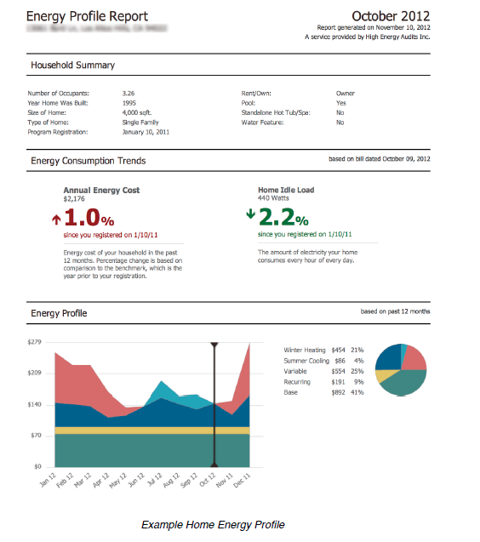
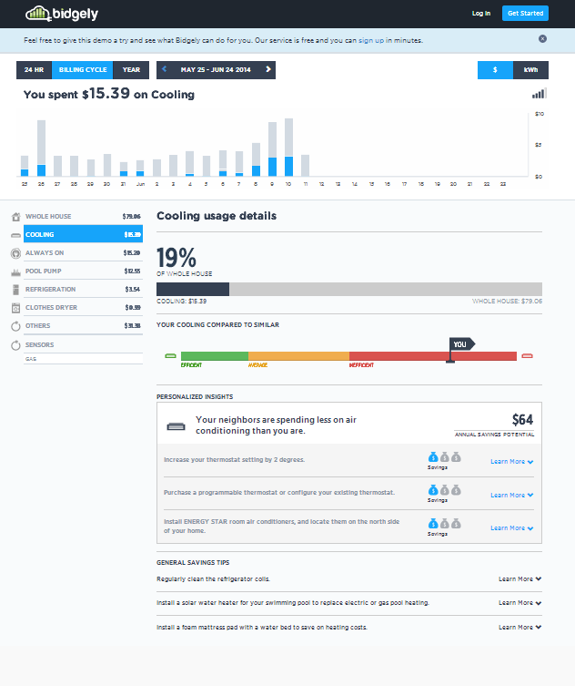
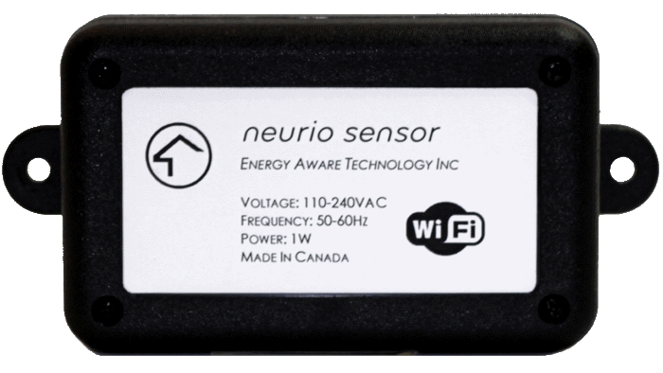
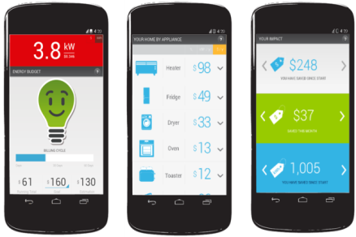
Background
Utilization and sharing of fine-grained energy usage data by third-party service providers have been increasing.
E.g., Green Button
Visualization, analytics, advise for energy efficiency, gaming for fun, etc.
https://www.bidgely.com
https://www.neur.io
http://corp.hea.com
1
Copyright 2014 Fujitsu Laboratories of America

Slide 3
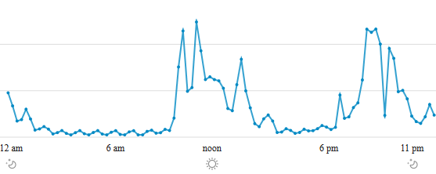
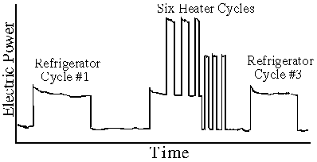
Motivation
Energy usage data collected at unprecedented granularity would cause privacy risks (e.g., Non-intrusive Load Monitoring)
Life style of residential customers
Appliances used in each household
Sleeping?
Not at home?
Source: http://georgehart.com/research/nalm.html

Slide 4
Motivation (Related Work)
While privacy preservation in collection of smart meter data has been explored, privacy issues in sharing of energy usage data between customers and third-parties are not enough explored.
A. Rial and G. Danezis, “Privacy-preserving smart metering” (ACM WPES 2011)
E. Shi, T.-H. H. Chan, E. G. Rieffel, R. Chow, and D. Song, “Privacy-preserving aggregation of time-series data.” (NDSS 2011)
A. Molina-Markham, G. Danezis, K. Fu, P. J. Shenoy, and D. E. Irwin, “Designing privacy-preserving smart meters with low-cost microcontrollers.” (FC 2012)
and more (including other papers presented in this session)
Our work is orthogonal to these and aims at privacy control when sharing the collected energy usage data.

Slide 5
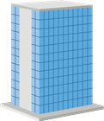
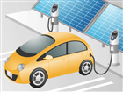
Customer-centric Data Management
“Customer-centric Energy Usage Data Management and Sharing in Smart Grid Systems” (ACM SEGS 2013)
Customer’s electricity data is collected by utility, then is downloaded by Customer.
Downloaded data is stored on “Repository”, which managed under Customer’s control.
Upon sharing with Service provider, data can be “pre-processed” for privacy, without losing data authenticity
E.g., Redactable Signatures
Signed & pre-processed
Energy usage data
Service Provider (Data Consumer)
Signed energy usage data
Privacy
Control
Customer
(Data Subject)
4
Customer Repository
Smart
Meter
Utility (Data Issuer)
4
Copyright 2014 Fujitsu Laboratories of America

Slide 6
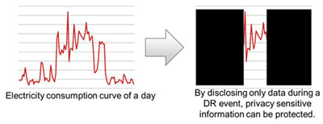
Customer-centric Data Management
Limitations
Pre-processing using Redactable Signatures can hide arbitrary portion of data, without invalidating digital signature, and thereby customers can limit privacy risks.
At the same time, it could lower the capability of data analytics
E.g., disconnected series of data would prohibit application of some popular machine learning techniques, such as ARIMA
While minimized, disclosed portion may still leak some privacy sensitive information, e.g., by means of NILM
5
Copyright 2014 Fujitsu Laboratories of America

Slide 7
High-level Idea of Proposed Mechanism
By adding artificial, controlled noises, allow customers to hide details in consumption patterns to enhance privacy
Customers can add arbitrary amount of nose based on the service agreement with service providers, privacy preference, and level of trust on service providers
At the same time, loose authenticity of noisy data should be verifiable by data consumers
Original, read energy consumption data was issued by a trustworthy entity (e.g., utility)
Added noise is bounded to the amount claimed by each customer
6
Copyright 2014 Fujitsu Laboratories of America

Slide 8
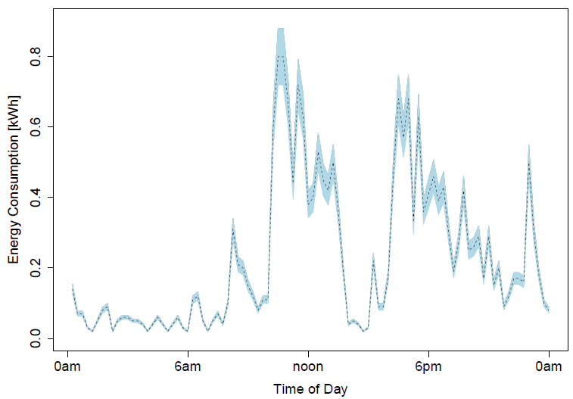
High-level Idea of Proposed Mechanism
E.g., add noise up to 10% of individual values
Can hide fluctuation and exact height of peaks in high-usage periods.
Effective to counter NILM attacks, re-identification attacks etc.
7
Copyright 2014 Fujitsu Laboratories of America

Slide 9
Primitives for Construction
Digital signatures (Integrity and authenticity)
Public-key encryption (Confidentiality)
Non-interactive Zero-knowledge Proofs
Language for NIZK Proof System:
m is a energy consumption value(s)
Sig is utility’s digital signature on it
Added noise is bounded by ε
e is ciphertext of a pair of m and sig encrypted with customer’s public key
8
Copyright 2014 Fujitsu Laboratories of America

Slide 10
Security Properties
Correctness of the protocol: If the data consumer (third party) accepts the proof and m′, then the deviation of m′ is bounded from data signed by the data issuer (utility).
By the soundness of the NIZK proof system for L, we have: there exists (m, sig), such that m′ is within a noise bound of m and sig passes the verification test with the data issuer’s verification key for the message m and that e is an encryption of such a message-signature pair.
Hiding of original data: The data consumer (third party) learns nothing beyond correctness about the real m.
By the zero-knowledge property of NIZK proof system and IND-CPA property of public key encryption scheme, we can show that the distribution of the message sent by customer to third party is computationally indistinguishable from a distribution which doesn’t use m at all.
9
Copyright 2014 Fujitsu Laboratories of America

Slide 11
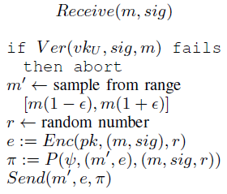
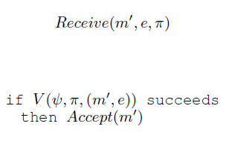
Protocol Definition
Third Party
(Data Consumer)
Utility (Data Issuer)
Customer (Data Subject)
Customer can verify signature on downloaded data.
When sharing is necessary, customer can generate noisy data and prepare NIZK proof.
Utility signs energy usage data to be downloaded
Third Party verifies the NIZK proof. When successful, data can be used for later processing
10
Copyright 2014 Fujitsu Laboratories of America

Slide 12
Conclusions
Designed a privacy-preservation scheme for sharing of energy usage data, using Non-interactive Zero-knowledge Proof system.
Mitigate privacy risks by added noise
Allow the pre-processed data to be for services that require trustworthy data
Allow broader range of machine learning techniques to be applied
Future Work
Practical implementation of the proposed scheme and evaluate its overhead and effectiveness is needed.
Implementation on the popular data sharing scheme like Green Button
Quantitative evaluation of how much NILM can be made difficult
Explore an optimal way to add noise for privacy goals
Combination with other privacy-preserving schemes, e.g., Redactable Signatures, to further enhance the privacy control
11
Copyright 2014 Fujitsu Laboratories of America

Slide 13
Email: dmashima@us.fujitsu.com

