Slide 1
Customer-centric Energy Usage Data Management for Balancing Tradeoff of Benefit and Privacy
Daisuke Mashima, Ph.D.
Fujitsu Laboratories of America (Sunnyvale, CA)
November 4, 2015
IEEE SmartGridComm 2015, Miami, FL

Slide 2
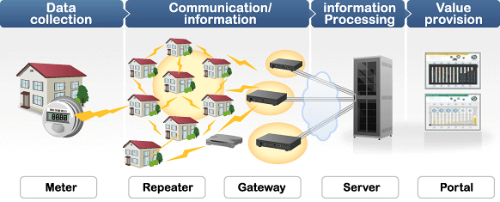
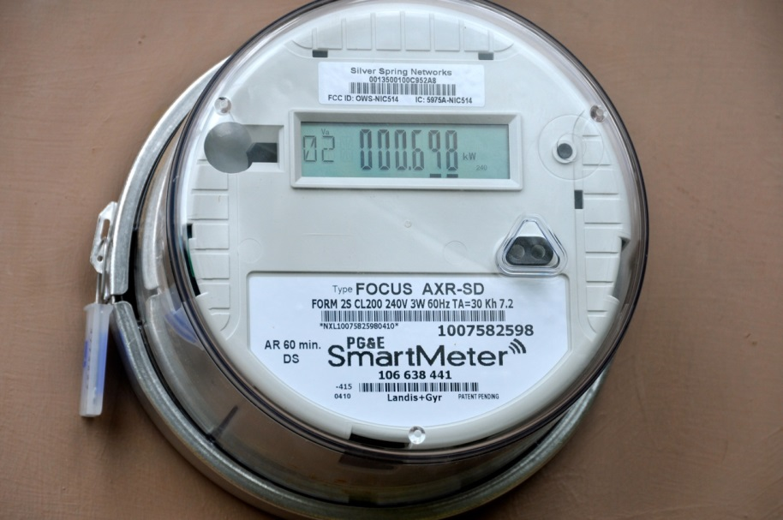
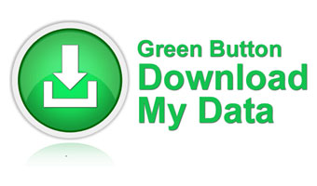
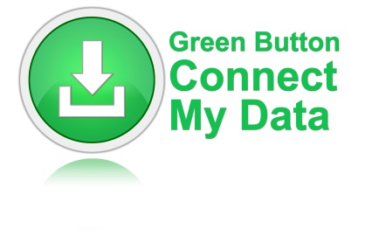
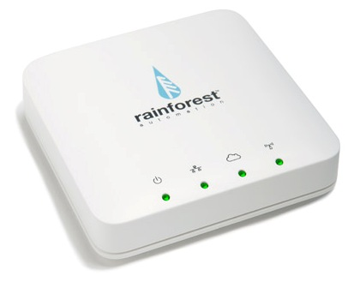
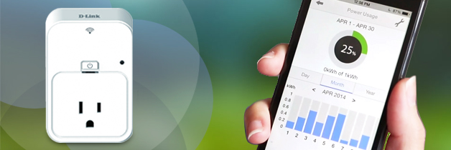
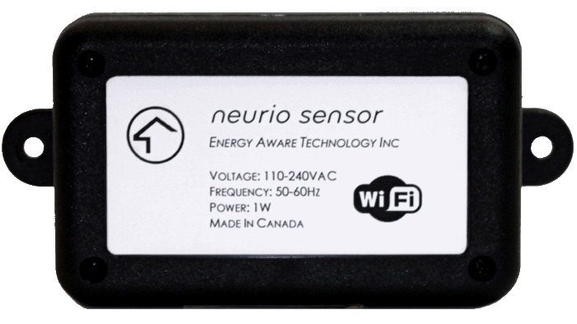
Growing Availability of Energy Usage Data
Fine-grained electricity usage data is now available.

Slide 3
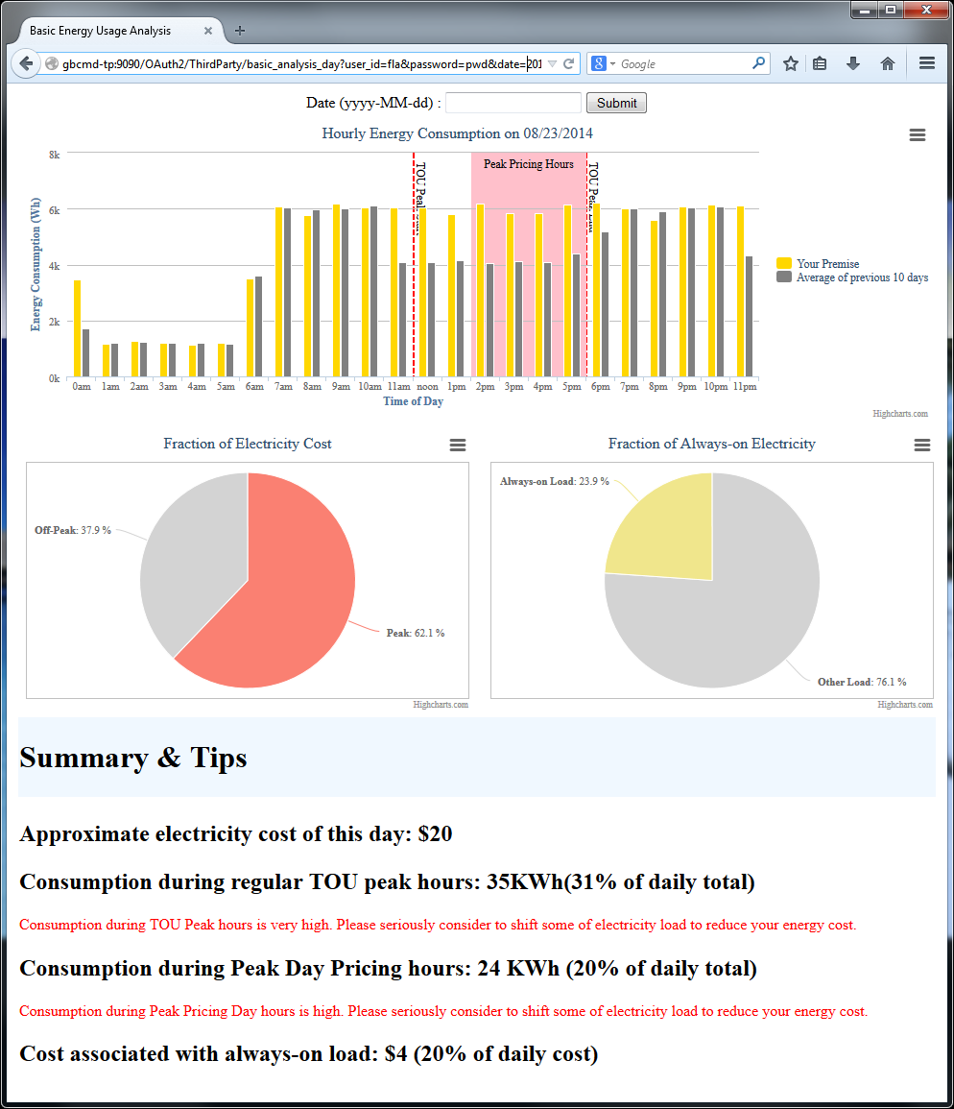
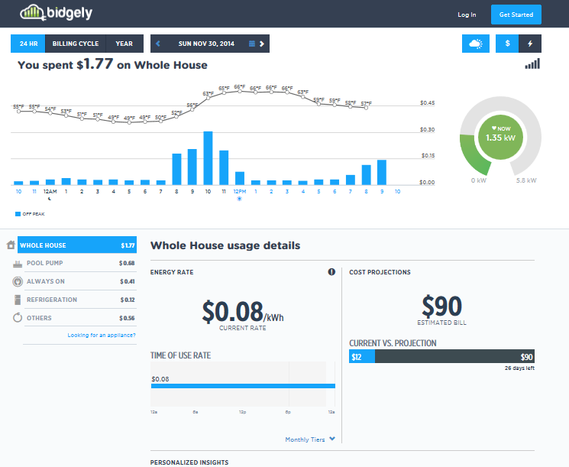
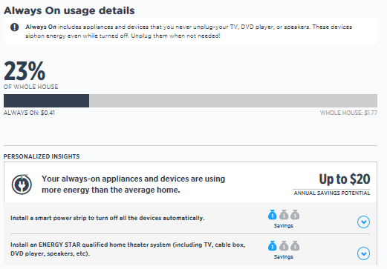
Utilization for Electricity Customers
Energy Usage Data Analytics Services by third parties
www.bidgely.com

Slide 4
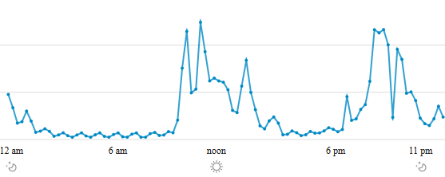
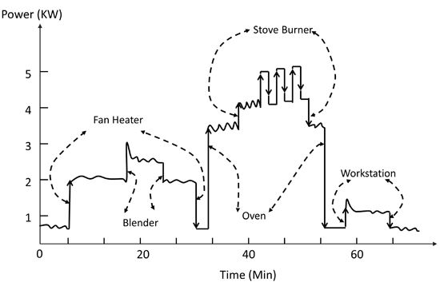
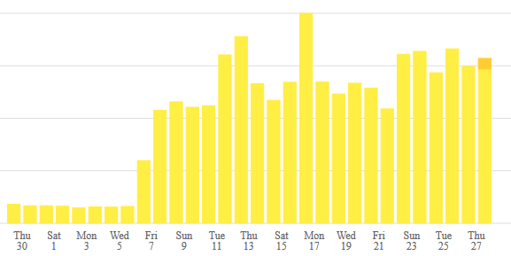
Privacy Risks?
Sleeping?
Detailed Appliance Usage by NILM
Not at home?
Vacation?
http://www.mdpi.com/1424-8220/12/12/16838

Slide 5
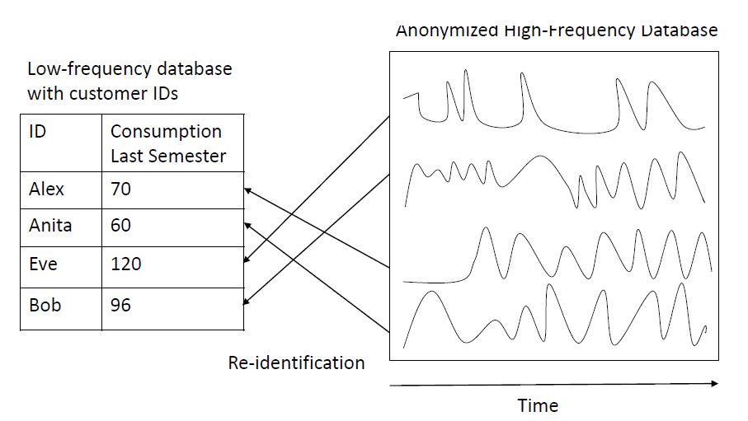
Re-identification
Mustafa Faisal, Alvaro Cardenas, and Daisuke Mashima, “How the Quantity and Quality of Training Data Impacts Re-identification of Smart Meter Users?” In Proc. of IEEE SmartGridComm 2015.

Slide 6

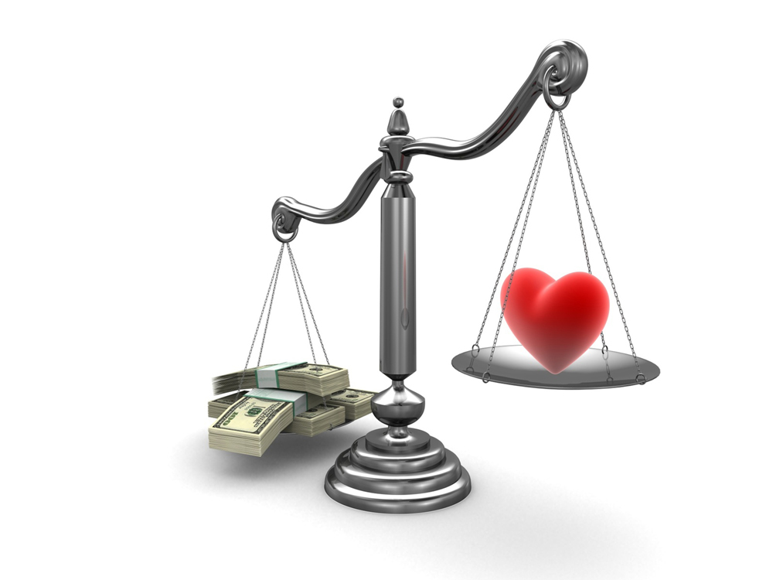
Balancing Benefit vs Privacy
Better understanding through data analytics
Monetary gain through demand response and energy efficiency efforts
Etc.
Revealing life cycle
Revealing appliance usage pattern
Revealing employment style
Revealing household details
Etc.

Slide 7

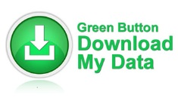






Customer-centric Data Management
Customer’s electricity data is collected and signed by utility (or a trusted metering device), then is downloaded by a customer.
Downloaded data is stored on a customer’s “Repository”.
Upon sharing with Service provider, data can be pre-processed for controlling privacy risks.
Authenticity of pre-processed data is verifiable.
Signed & pre-processed
Energy usage data
Service Provider (Data Consumer)
Signed energy usage data
Privacy
Control
Customer
(Data Subject)
7
Customer Repository
Smart
Meter
Utility (Data Issuer)

Slide 8
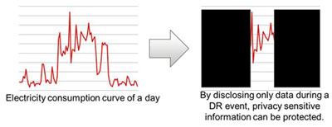
Privacy by Redaction
Authenticity of disclosed
portion can still be verified
Hide non-essential part for minimal disclosure
  Application of Redactable Digital Signature scheme
  Gaurav Lahoti, Daisuke Mashima, and Wei-Peng Chen, "Customer-centric Energy Usage Data Management and Sharing in Smart Grid Systems." In Proc. of ACM Smart Energy Grid Security Workshop, Berlin, Germany, 2013.

Slide 9
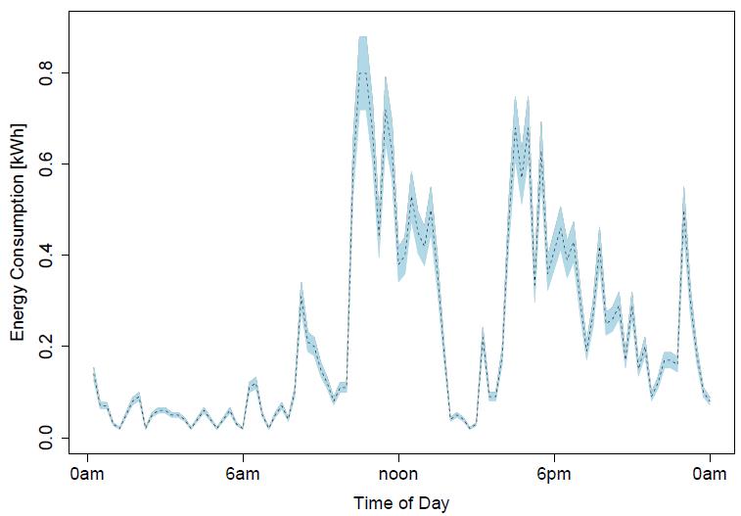
Privacy by Artificial, Bounded Noise
While detailed pattern
can be hidden,
“loose authenticity”
can still be verified
Adding artificial, bounded noise to counter attacks such as signature-based NILM
  Protocol based on Non-interactive Zero-knowledge Proof system
  Daisuke Mashima and Arnab Roy, "Privacy Preserving Disclosure of Authenticated Energy Usage Data." In Proc. of IEEE SmartGridComm 2014.

Slide 10
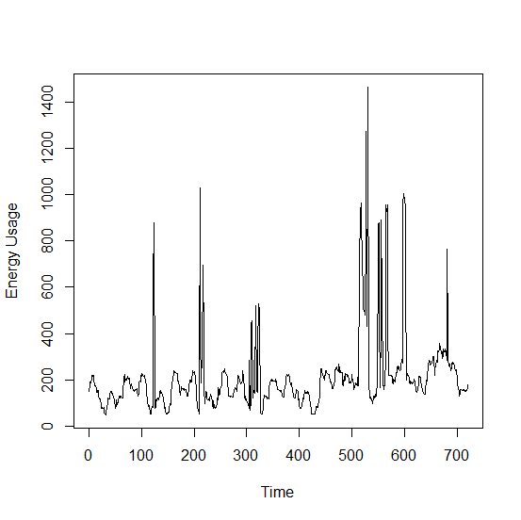
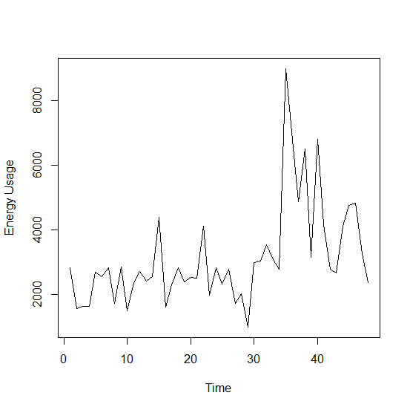
Privacy by Down-sampling
Verifiable, continuous,
accurate data but
with lower granularity
Lower data granularity to counter risks caused by data analytics
  Extension of Redactable Digital Signature based on Merkle Hash Tree
  Daisuke Mashima, “Authenticated Down-Sampling for Privacy-Preserving Energy Usage Data Sharing.” To appear at IEEE SmartGridComm 2015.

Slide 11
Summary
Utilization of electricity usage data benefits not only utility companies but also electricity customers.
Electricity customers should be aware of associated privacy risks.
  Quantification of privacy risk is a challenging future work.
Addressing privacy concerns will further encourage sharing and meaningful utilization of electricity data.
To empower customers to control privacy risks, customer-centric data management and sharing are essential.
  Allow electricity customers to pre-process data
  Retain data verifiability for services that require trustworthy data

