Slide 1


Authenticated Down-sampling for
Privacy-preserving Energy Usage
Data Sharing
(on November 5, 2015 at IEEE SmartGridComm 2015)
Daisuke Mashima
Fujitsu Laboratories of America, Inc.
Sunnyvale, CA

Slide 2
Outline
Motivation
Authenticated down-sampling
Security Discussion
Performance and Overhead
Application to Green Button
Conclusions

Slide 3
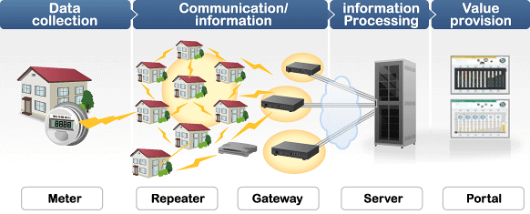
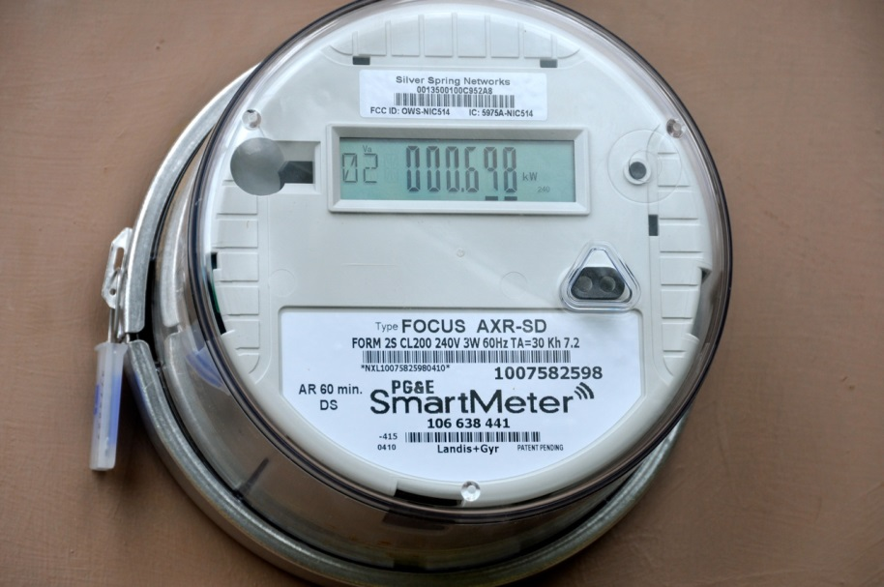

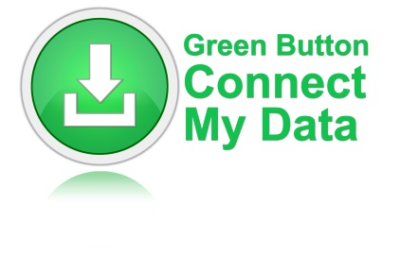
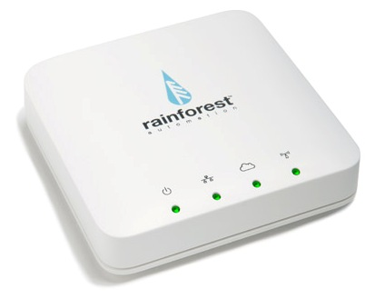
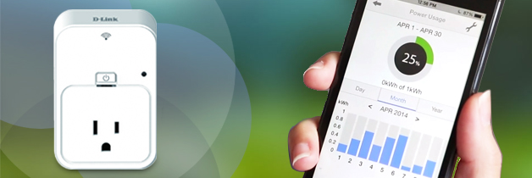
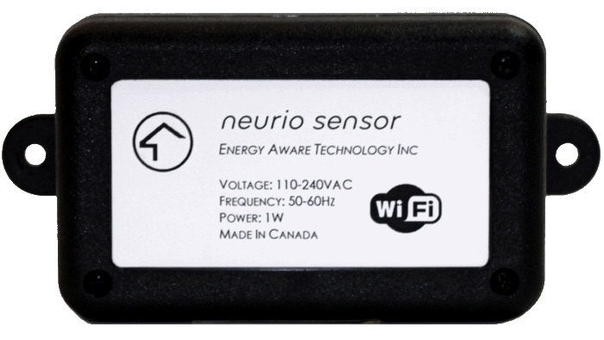
Availability of Energy Usage Data
Fine-grained electricity usage data is now available.

Slide 4

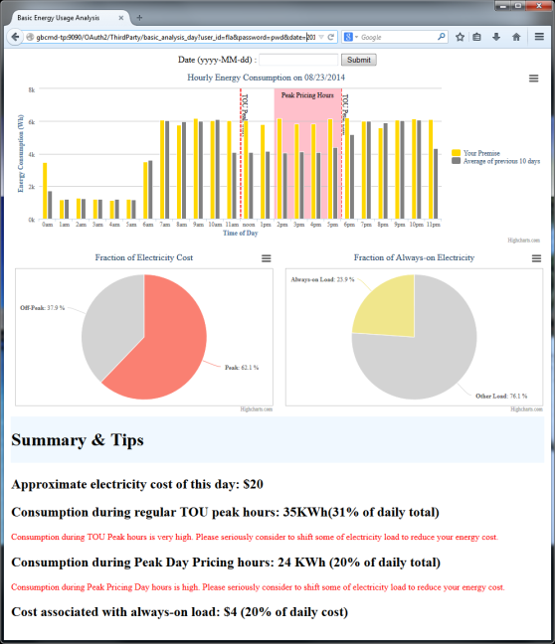
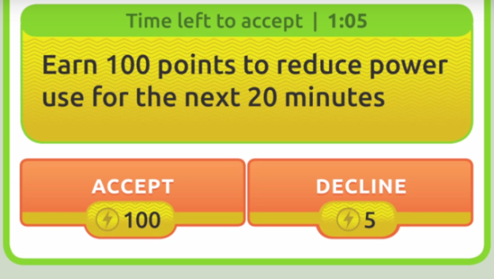
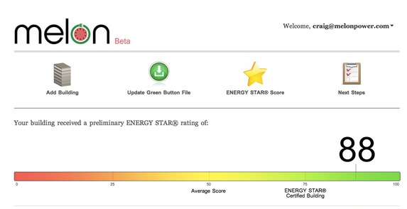
Utilization of Energy Usage Data
For electricity customers:
  A number of services provided by third parties
    Analytics & visualization for energy efficiency
    Social gaming, energy efficiency competition
    Certification and audit
    Energy efficiency credit and demand response incentive
Leafully.com
DRIVE
Melon Beta

Slide 5
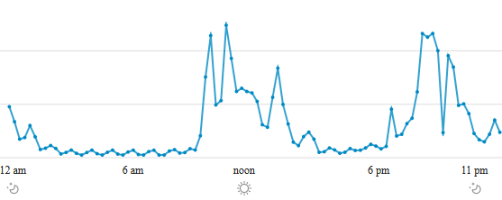
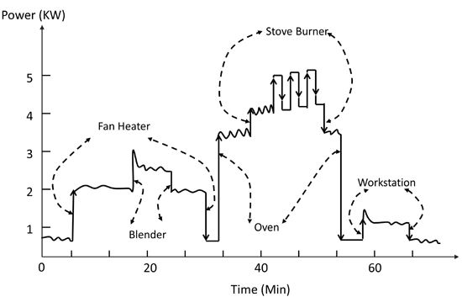
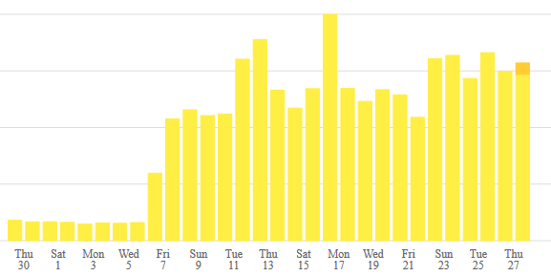
Privacy Concerns (in General)
Sleeping?
Detailed Appliance Usage
Not at home?
Vacation?
http://www.mdpi.com/1424-8220/12/12/16838

Slide 6

Can We Balance Benefit and Privacy Risk?
Revealing life cycle
Revealing appliance usage pattern
Revealing employment style
Etc.
Goals:
Electricity Customer should be able to control privacy risks upon sharing of energy usage data
Data Consumer (service provider) often needs trustworthy data for their services. → Data Authenticity
Better understanding through data analytics
Monetary gain through demand response and energy efficiency efforts
Etc.

Slide 7
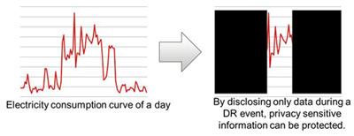
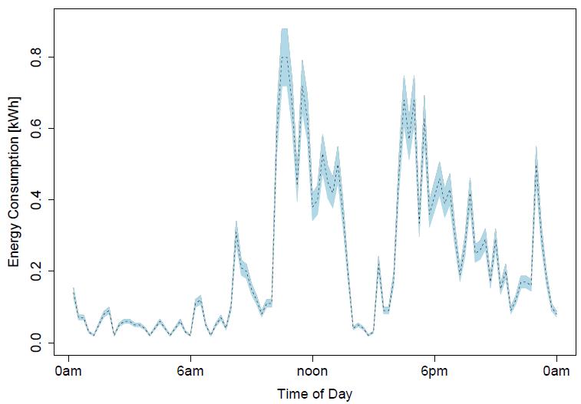
Related Work: Balancing Utility and Privacy
Customer-centric Energy Usage Data Management (ACM SEGS 2013)
  Framework that enables customers to control privacy risks
  Application of redactable digital signatures for minimal disclosure
    Result in disconnected data
Privacy protection by artificial noise
(IEEE SmartGridComm 2014)
  Application of Non-interactive
  Zero-knowledge Proof System
    Result in “inaccurate” data

Slide 8
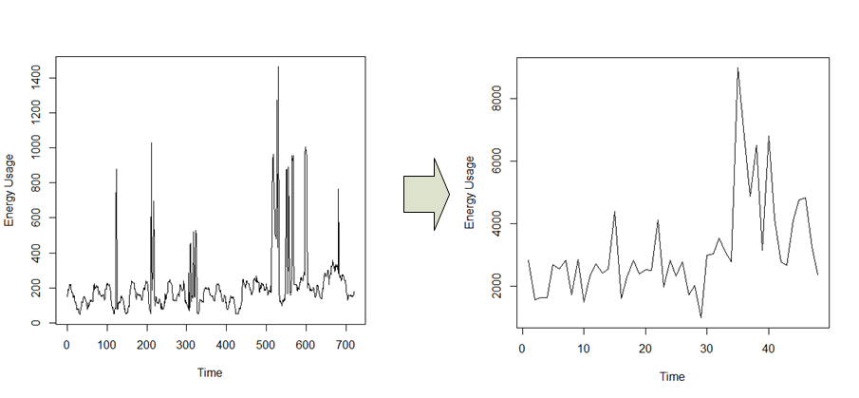
Authenticated Down-sampling
Finer-grained energy usage data is considered more vulnerable against attacks such as Non-intrusive load monitoring.
  Down-sampled data is continuous and still accurate.
Enable down-sampling without losing data verifiability

Slide 9
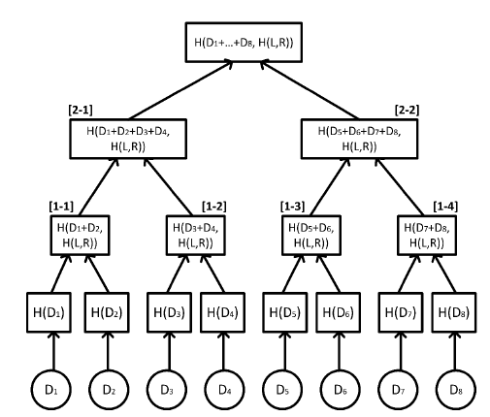
Construction
Extenition of Merkle Hash Tree based Digital Signature
Root hash value is
signed by an issuer
An intermediate node
is calculated as
hash value of sum of
raw data and children
hash values
Hash values of
raw data points
Raw data points

Slide 10
How It Works
Sharing signed data of highest granularity
Sharing signed data that are down-sampled by 1 level
Sharing signed data that are down-sampled by 2 levels
Sharing signed data with mixed down-sampling levels
D1
D2
D3
D4
D5
D6
D7
D8
SIG
D1+D2
D3+D4
D5+D6
D7+D8
SIG
H(D1)
H(D2)
…
H(D8)
D1+D2+D3+D4
D5+D6+D7+D8
SIG
…
H(D1+D2,H(L,R))
H(D7+D8,H(L,R))
D1
D2
D3
D4
D5+D6
D7+D8
SIG
H(D5)
…
H(D8)

Slide 11
Security Discussion (1)
Confidentiality of higher granularity data than one disclosed
  Provided by security property of secure hash function
    E.g., in the case of data down-sampled by 2 levels,
  do not reveal D1+D2, D3+D4, …, or D7+D8.
Integrity of down-sampled data
  Tampering / Forgery?
    When any disclosed value is tampered or
    forged, it generates a different hash value.
  The resulting root hash value will be
  different from the one originally signed.
…
H(D1+D2,H(L,R))
H(D7+D8,H(L,R))

Slide 12
Security Discussion (2)
Integrity of Down-sampled data (contd.)
  Re-ordering?
    Calculation of [2-1] results in H(D3+D4+D1+D2, H([1-2],[1-1])),
    The resulting root hash value will be different from one originally signed.
D3+D4
D1+D2
D5+D6
D7+D8
SIG
H(D3)
H(D4)
H(D1)
H(D2)
…
H(D8)

Slide 13
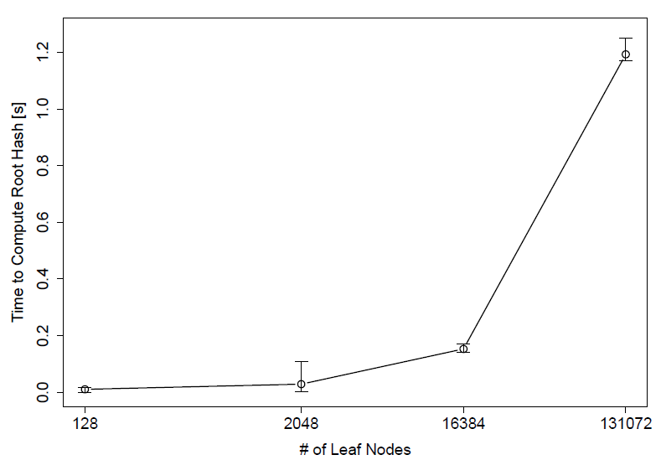
Performance & Overhead
Computation Time to calculate root hash value
Communication Overhead
  If the number of measurements included is 128, and down-sampled by one level, we need to include 128 hash values,
  When SHA256 is used, overhead is about 4 KBytes.
15-minute interval reading per day
1-second interval reading per day
1-minute interval reading per day

Slide 14
Application to Green Button
0..1
LocalTime
Parameters
SignatureInformation
UsagePoint
1
ServiceCategory
HashInformation
<IntervalReading>
<timePeriod>
<duration>900</duration>
<start>1430463600</start>
</timePeriod>
<value>134</value>
<ChildHash>
<interval>0</interval>
<hash>….</hash>
</ChildHash>
<ChildHash>
<interval>1</interval>
<hash>….</hash>
</ChildHash>
</IntervalReading>
0..*
MeterReading
0..*
IntervalBlock
0..*
ElectricPower
UsageSummary
1
0..*
ReadingType
IntervalReading
0..*
ElectricPower
UsageSummaryHash
0..*
0..*
0..*
ElectricPower
QualitySummary
ReadingQuality
ChildHash

Slide 15
Conclusions
Authenticated down-sampling allows:
  Electricity customer to flexibly lower granularity of electricity usage data to be shared with third parties, thereby controlling privacy risks
  Third-party service providers to still verify data authenticity by mean of data issuer’s digital signature, so resulting data can be used even for billing / accounting purposes.
Integration into standard Green Button data model is straightforward and compatible with current systems
  Minimum change is needed for current implementation
Future work includes:
  Quantitative evaluation of privacy gain/loss for each down-sampling level

