Slide 1
Residential Demand Response System Framework Leveraging IoT Devices
Daisuke Mashima
Advanced Digital Sciences Center
Singapore (Formerly with Fujitsu)
November 9th, 2016
Wei-Peng Chen
Fujitsu Labs of America, Inc.
U.S.A.

Slide 2
Outline
Motivation
Benefits and challenges in large-scale residential demand response services
Design and implementation of residential DR system
Mobile app DR client
Standard-compliant, comprehensive DR server framework
Performance measurements
Demo Video
Critical Peak Pricing
Conclusions

Slide 3
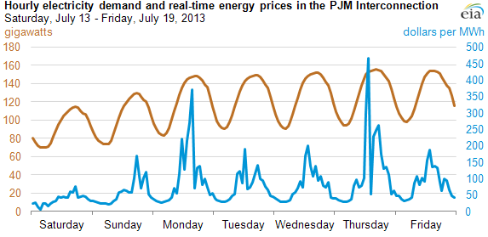
Residential DR can relieve utility’s pain point
Utility’s pain point: utilities pay high costs for electricity supply to meet peak demand while customers pay flat rate to utilities
Source: EIA
Utilities
DR can help !

Slide 4
Residential DR has great potential but not yet popular
Unit($ Million)
Gap
Source: Navigant Research
Market forecast for Demand Response (DR) services in C&I (Commercial & Industrial) and Residential sectors
Barriers to expand residential DR adoption
1. Customer acquisition
2. Customer engagement

Slide 5
Barrier for residential DR - customer acquisition
Problem 1: High introductory cost. Examples include:
Rebates for Bring Your Own Thermostat (BYOT) program
Hardware-based home gateways (around $200)
Problem 2: Limited choices of DR programs may preclude customers with various preferences from participation
Some customers may not like their appliances being controlled by utility, and therefore stay away from Direct Load Control (DLC) program
Customers’ freedom in selection of smart appliances is often constrained.
Solution:
A scalable, comprehensive residential demand response system framework with support of multiple DR programs as well as easy integration of a variety of IoT devices (e.g., smart appliances) of customers’ preferences.

Slide 6
Barrier for residential DR - customer engagement
Problem 1: Ineffective conventional communication channels with customers, e.g. paper bill, web portal, email, SMS, or phone calls
These are often one-way communication (from utilities to customers) and not scalable
With insufficient customer input, forecast DR capacity becomes difficult
Problem 2: Lack of convenient, user-friendly DR interface
Without automation, DR fatigue would happen quickly, and customers start ignoring DR signals.
Solution:
A mobile app DR client, which enables timely, bi-directional communication between utility and customers as well as automated control tailored to each customer’s smart home configuration.

Slide 7
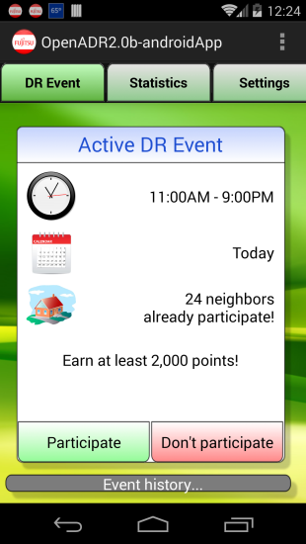
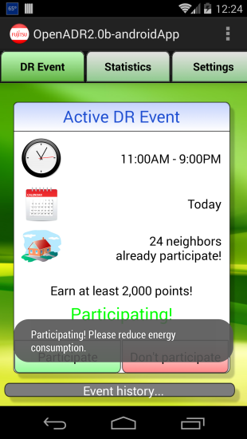
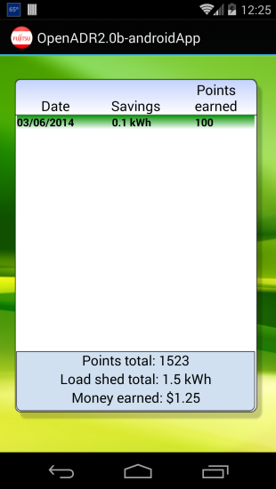
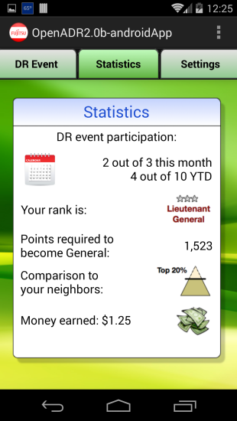
Mobile App DR Client - Advantages
A bi-directional, real-time channel between utilities and consumers
⇨ Real-time feedbacks provide better reliability
Cost-effective platform
No hardware hub/gateway needed
Low cost, easy installation
Support multiple DR programs
Lower customer acquisition cost
Automated, informative features to enhance customer engagement
⇨ Automated control of multiple IoT devices
⇨ Informative energy data analytics

Slide 8
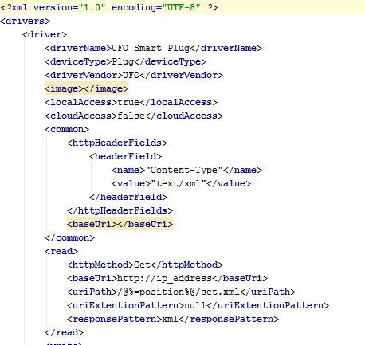
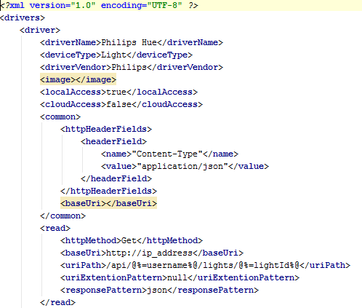
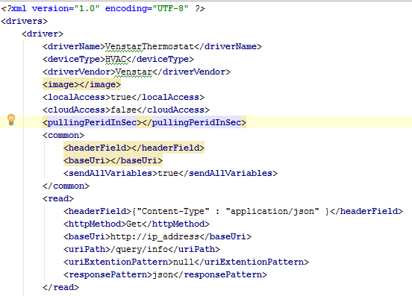
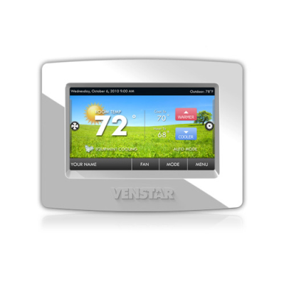
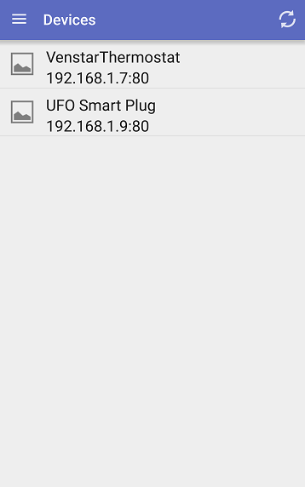
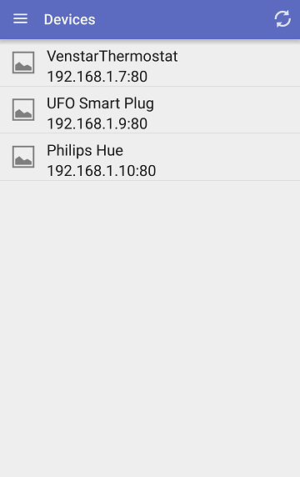
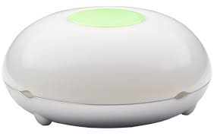
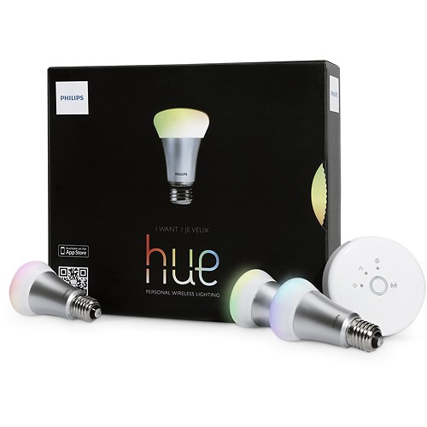
Mobile App DR Client – SPOT Overview
DR Client App implemented on SPOT platform
“SPOT: A Smartphone-Based Platform to Tackle Heterogeneity in Smart-Home IoT Systems.” To appear IEEE WF-IoT 2016.
SPOT Mobile App

Slide 9
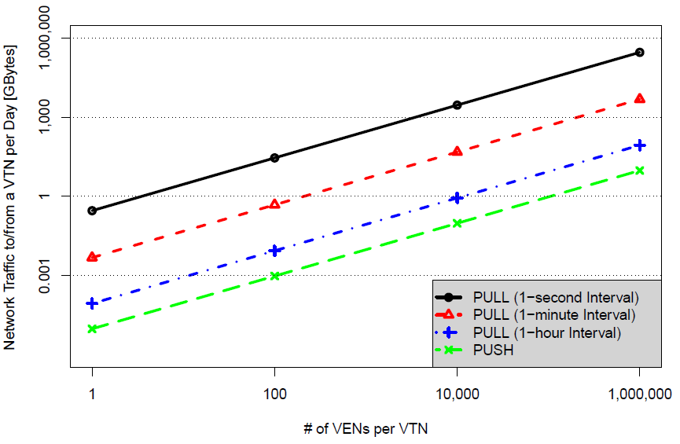
Mobile App DR Client - Communication
Scalable communication with DR Server
OpenADR 2.0?
Communication overhead is not negligible
Requirement of TLS with client authentication is too costly.
Defined JSON-based message schema based on OpenADR
Simplified authentication (TLS with ID / password)
Take advantage of push notification framework (e.g., Google Cloud Messaging) to avoid periodic polling
EiEvent (DR event signal):
Assume 1 Demand Response event a day, which contains minimal parameters
Ulrich Herberg, Daisuke Mashima, Jorjeta Jetcheva, and Sanam Mirzazad-Barijough, "OpenADR 2.0 Deployment Architectures: Options and Implications." In Proc. of IEEE SmartGridComm 2014.

Slide 10
Different Kinds of DR Programs
Multiple types of DR programs exist
E.g. Critical Peak Pricing (CPP), Peak Time Rebate (PTR), Direct Load Control (DLC) program
Utilities would like to employ different DR programs to attract residential customers with different preferences
BUT, the complexity of handling multiple programs is non-trivial
 | CPP | PTR | DLC
Category | Time-based | Time-based | Incentive-based
Rewards | Lower off-peak rates | Performance-basis | Compliance-basis
Electricity rate | Dynamic | Flat | Flat
Limited calls | Yes | No | Yes
Direct control | No | No | Yes
9
Copyright 2016 Fujitsu Laboratories of America, Inc.

Slide 11
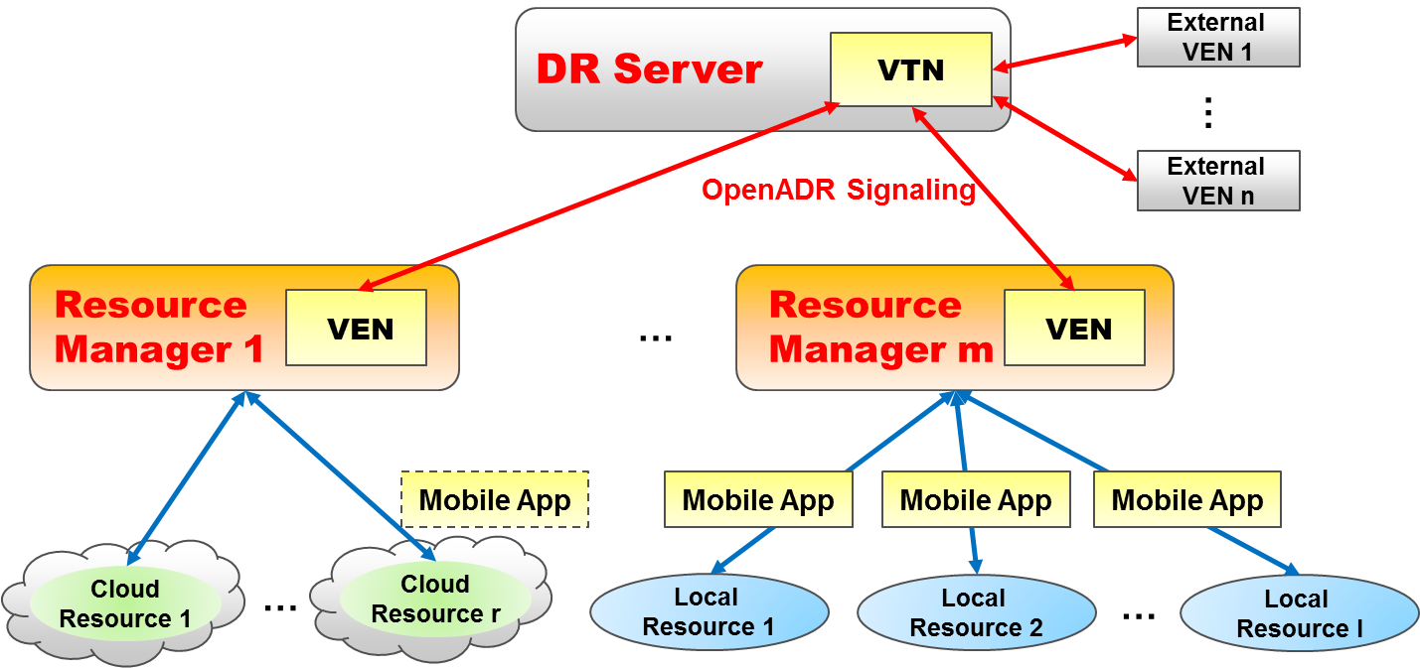
Proposed Residential DR Framework
Compliant to standard to interoperate with other DR systems
Support multiple DR programs and devices, and enables fine-grained control.
Each Resource Manager can be seen as “internal DR aggregator” and implement different types of DR program and/or handle different types of IoT devices.
VTN: Virtual Top Node
VEN: Virtual End Node

Slide 12
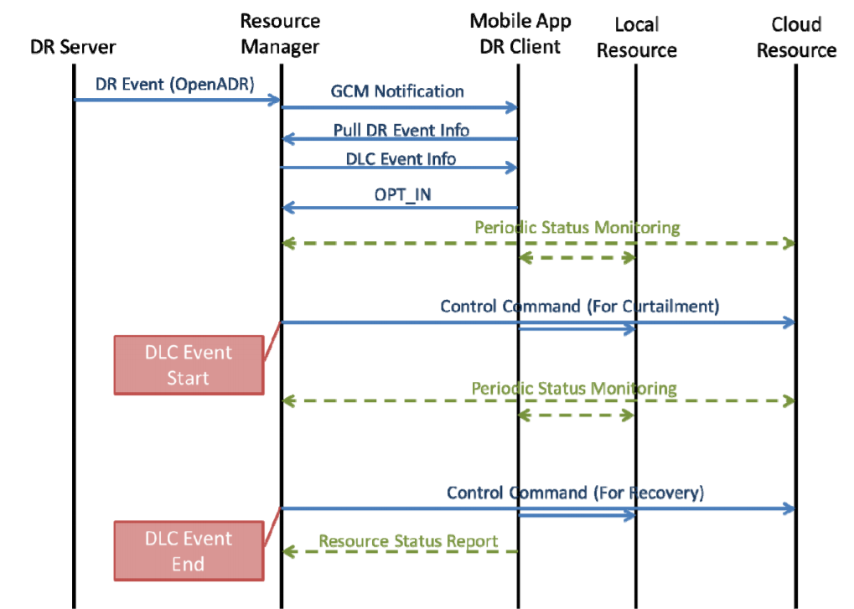
Overall Communication Sequence

Slide 13
Performance Measurements
Control latency
Time to invoke appliance control via mobile app DR client is short enough to support Fast DR, which requires response time within 4sec.
Event polling time: 2-3 sec
Control: 150ms
Communication scalability (DR Event Polling)
Experiment using JMeter
Over 300k requests per hour even with a single, low-end server
If polling timing is appropriately distributed, worst-case latency is reduced significantly.

Slide 14
Residential DR Demo (CPP)

Slide 15
Conclusions
Residential DR is promising to enhance flexibility of demand side management
In this work, we proposed a residential DR system that can
Address customer acquisition and engagement challenges
Handle large number of customers
Mobilize a variety of IoT smart-home devices for DR
Future direction
Evaluation of the system in a utility-scale residential demand response pilot project
Acknowledgement
The authors gratefully acknowledge the significant contributions of Jorjeta Jetcheva, Ulrich Herberg, Sanam Mirzazad-Barijough, Mohammad Moazzami, Kiyoshi Nakayama, and Grishma Shah to complete this work.

