Slide 1
An Active Command Mediation System for Securing Remote Control Interface of Electrical Substations (IEEE SmartGridComm 2016)
Daisuke Mashima
Prageeth Gunathilaka
Binbin Chen
Acknowledgment:
The work was in part funded under the Energy Innovation Research Programme (EIRP, Award No. NRF2014EWT-EIRP002-040), administrated by the Energy Market Authority (EMA) and in part by the research grant for the Human-Centered Cyber-physical Systems Programme at the Advanced Digital Sciences Center from Singapore’s Agency for Science, Technology and Research (A*STAR). The EIRP is a competitive grant call initiative driven by the Energy Innovation Programme Office, and funded by the National Research Foundation (NRF).
Version 2, WGT

Slide 2
Outline
Motivation: Need for additional layer of security for electrical substations
Related work
Design of Active Command Mediation (A*CMD) framework
Concrete mitigation mechanism on A*CMD
Simulation results
Conclusions

Slide 3
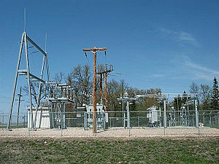
Electrical Substations
A substation is a crucial component of an power grid system delivering electricity from generation to loads.
Voltage transformation, switching, fault isolation, voltage regulation etc.
Between the generating station and consumer, electric power may flow through several substations at different voltage levels.
Over 10,000 transmission/distribution substations in Singapore

Slide 4
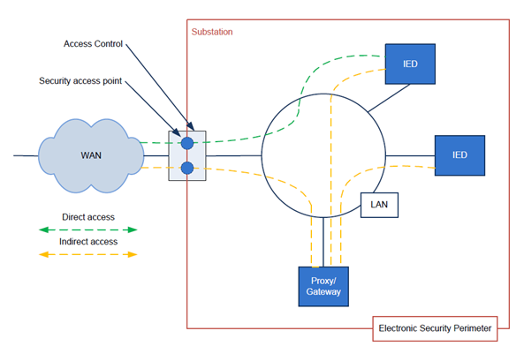
Modernization of Substations
Adoption of standard technologies such as IEC 60870-5-104 and IEC 61850 for remote control and automation
IEC 61850-90-2 TR: Communication networks and systems for power utility automation –
Part 90-2: Using IEC 61850 for the communication between substations and control centres - Page 10

Slide 5
Remote Control Use Cases
Power shedding
To handle over generation from renewables, the control center controls the output from the generation and/or makes it offline
Voltage regulation
Shunt reactors/capacitors are controlled (either on/off or variable setpoints) to manage voltages according to the change in loads
Topology control
To optimize generation and transmission cost, power grid topology is changed.

Slide 6
Security Risks
Attack from network
Insecure deployment of IEC 60870 and 61850 is vulnerable against man-in-the-middle attacks, replay attacks, etc.
B. Kang, P. Maynard, K. McLaughlin, S. Sezer, F. Andren, C. Seitl, F. Kupzog, and T. Strasser. Investigating cyber-physical attacks against iec 61850 photovoltaic inverter installations. In Emerging Technologies & Factory Automation (ETFA), 2015 IEEE 20th Conference on, pages 1–8. IEEE, 2015.
P. Maynard, K. McLaughlin, and B. Haberler. Towards understanding man-in-the-middle attacks on iec 60870-5-104 scada networks. In Proceedings of the 2nd International Symposium on ICS & SCADA Cyber Security Research 2014, pages 30–42. BCS, 2014.
Attack from the control center
Disgruntled insiders
Malware
Physical / Cyber intruders

Slide 7
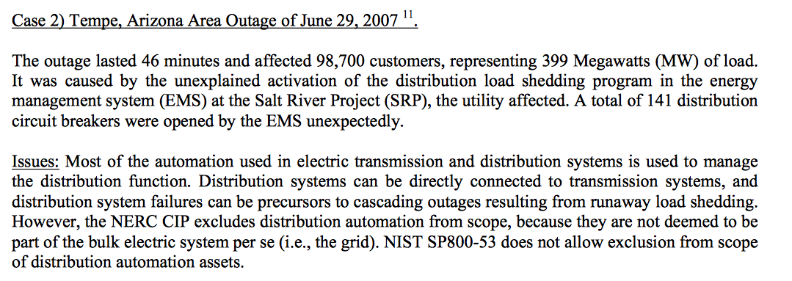
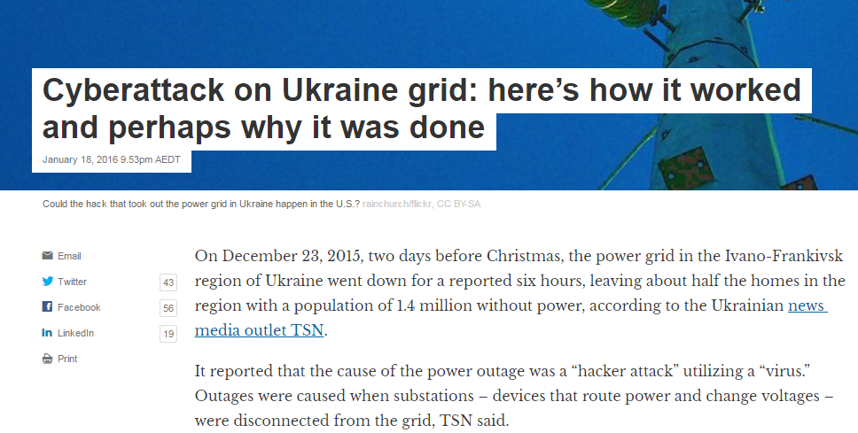
Threats Are Real!
http://realtimeacs.com/wp-content/downloads/pdfs/House-Hearing-10-17-Final.pdf
http://theconversation.com/cyberattack-on-ukraine-grid-heres-how-it-worked-and-perhaps-why-it-was-done-52802
Traditional trust assumption on the control center is no longer valid.
We need additional layer(s) of security to minimize physical impact of cyber attacks!

Slide 8
Related Work
Firewall, IDS, Anti-virus, user authentication, access control etc.
Once the control center becomes malicious, many of these are not fully effective.
Our work is intended to be complementary to these measures.
Runtime semantic security analysis by Lin et al. [TSG2016]
Shares threat model
Evaluate outcome of control commands in a centralized manner to detect attacks
They chose command-reversing approach, which may not be always suitable.
Our scheme can be used with their attack detection system.

Slide 9
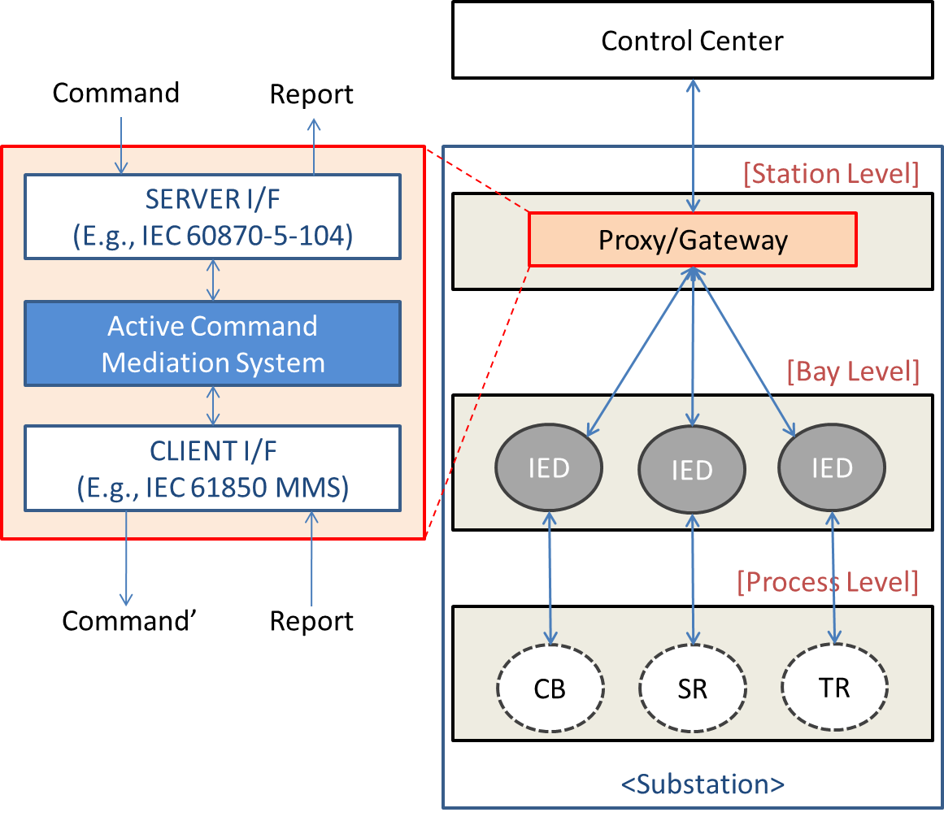
Active Command Mediation
Add additional-layer of security for securing remote control interface of substation
Inspect and “pre-process” incoming remote control commands
Should work autonomously
Can not be bypassed
Minimal dependency on external systems
Practically-deployable solution
Require minimal change on existing infrastructure
Add minimal overheads

Slide 10
Autonomous Command-delaying
Control
Center
Attacker
Proxy 1,…,n
IED1
IED2
IED3
IEDn
Send malicious commands
Command Ack
t0
d1
Execute Control
d2
d3
t1
Attempt Cancelaltion
dn
Attack detection system at the control center is assumed.
E.g., Hui Lin, Adam Slagell, Zbigniew Kalbarczyk, Peter W. Sauer, and Ravishankar K. Iyer, "Runtime Semantic Security Analysis to Detect and Mitigate Control-related Attacks in Power Grids," in IEEE Transactions on Smart Grid)
The number of attack commands executed is reduced, and thereby the resulting impact of attacks is also mitigated.

Slide 11
How Much Delay Can We Add?
IEEE PES Guideline
Communication between an external control center and substation:
normally greater than 100ms
Communication for line sectionalizing:
5 seconds
Communication for load shedding:
10 seconds
Communication for transfer switching:
1 second

Slide 12
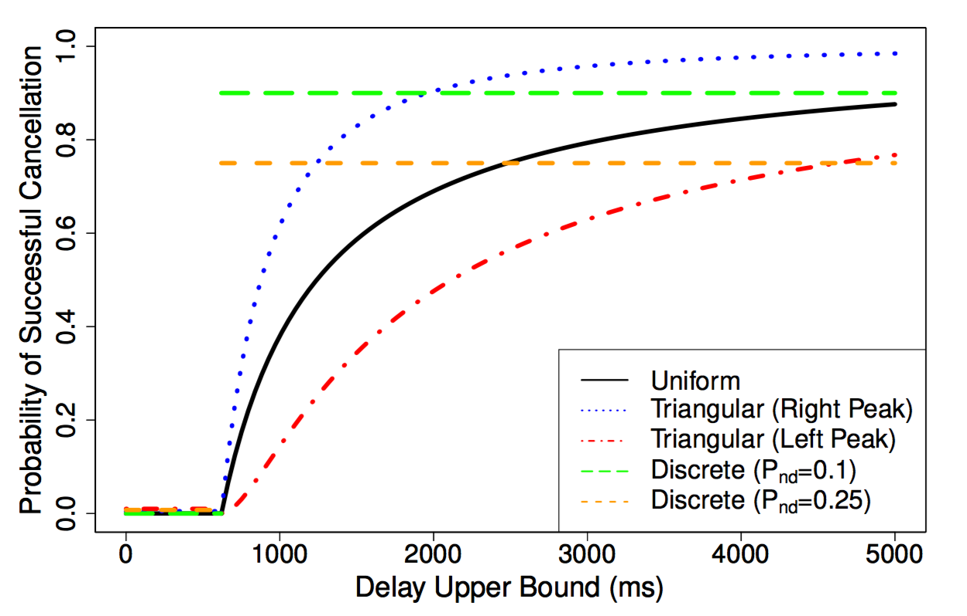
How Should Add Delay?
Option 1: Constant, long-enough delay
Option 2: Probabilistically-added constant delay
Option 3: Continuously-random delay(Future Work)
Probability of successful mitigation
- Detection & Response Time: 620ms
- Option 2: 75% & 90% delay probability
- Option 3: Uniform
Triangular with peak at
delay upper bound
Triangular with peak at 0

Slide 13
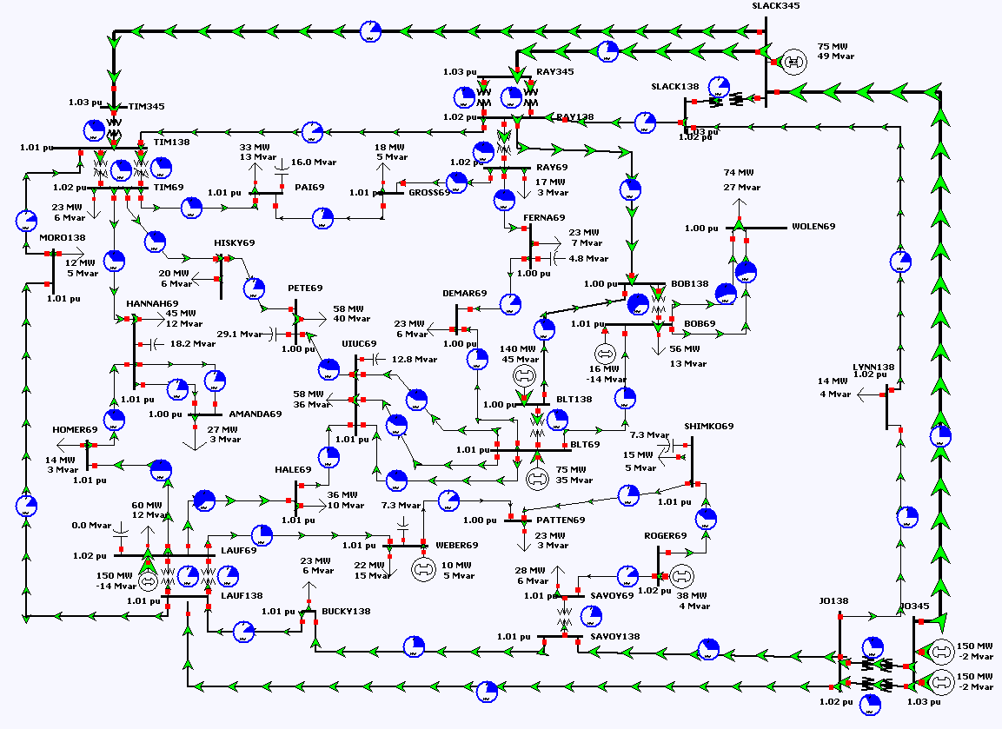
Setup for Simulation
PowerWorld Simulator
Transient stability analysis
GSO 37-bus system
57 transmission lines
Simulate attacks against circuit breakers
Issue open commands to randomly selected circuit breakers
Metrics of attack impact on power grid
Voltage violation
Frequency violation
Reduction in load (Unserved Load)
37-bus system on PowerWorld

Slide 14
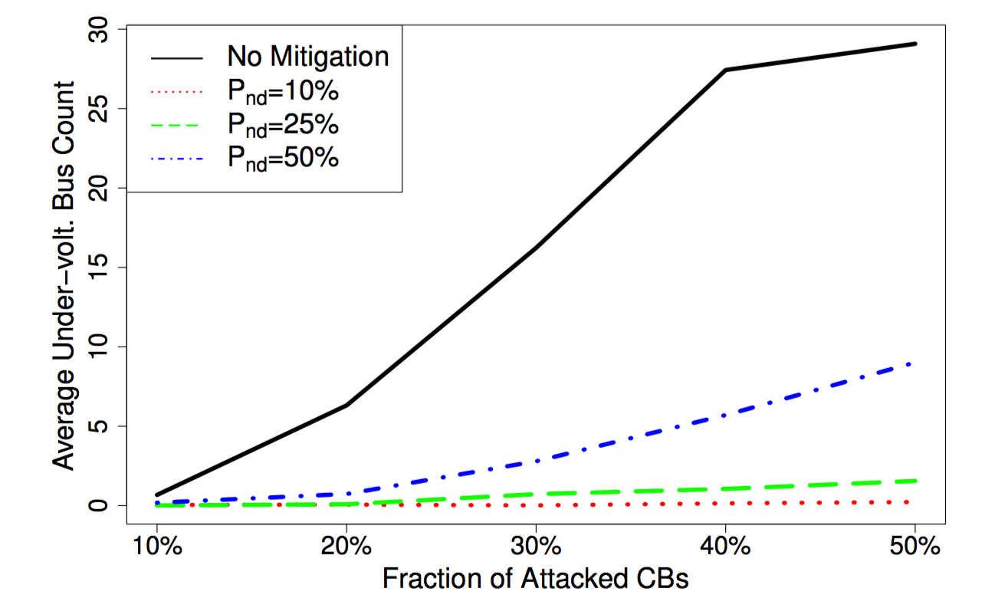
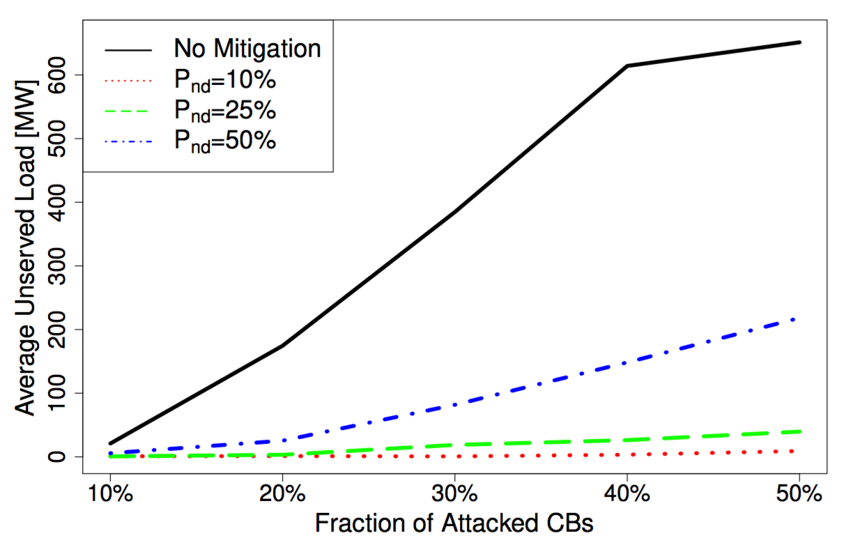
Simulation Results
Voltage Violation (20%)
Unserved Load
Over 90% mitigation in # of buses with voltage violation and unserved load
Even with practical attack detection accuracy (e.g., 80-90%), the proposed scheme is still expected to offer significant mitigation.

Slide 15
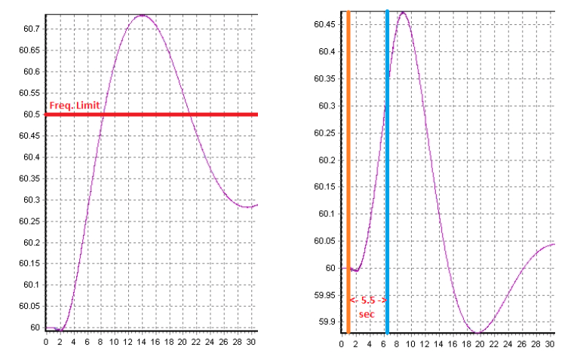
Preliminary Study of Acceptable Delay
Simulated a case requiring power shedding
Significantly increased generation MW of 3 out of 9 generators in 37-bus system
Delaying recovery controls up to 5.5 seconds did not cause any violation based on WECC criteria.
Even with tighter criteria (0.2Hz deviation), the recovery can be delayed up to 2 seconds.

Slide 16
Conclusions
Proposed and evaluated active command mediation approach with autonomous command-delaying
Effectively offers additional layer of security for substations
Can be introduced with minimal change on existing infrastructure
Is compatible with widely-used standards
Can potentially mitigate the impact of malicious remote control commands by 90+%
Future Work
Investigation on other delaying strategies
Context-aware, fully-autonomous command mediation system

Slide 17
Thank you very much!
Questions?
SoftGrid: Software-based Smart Grid Testbed for Evaluating Substation Cybersecurity Solutions
Companion paper was published at ACM CPS-SPC 2016
Available as an open-source project under GPL
Web: https://www.illinois.adsc.com.sg/softgrid/
Email: softgrid@adsc.com.sg

