Slide 1

Securing Substations through Command Authentication
Using On-the-fly Simulation of Power System Dynamics
Daisuke Mashima, Binbin Chen, Toby Zhou (ADSC)
Ramkumar Rajendran and Biplab Sikdar
(National University of Singapore)
This research is supported in part by the National Research Foundation, Prime Minister's Office, Singapore under the Energy Programme and administrated by the Energy Market Authority (EP Award No. NRF2014EWT-EIRP002-040) and is also partly supported by the National Research Foundation, Prime Minister’s Office, Singapore under its Campus for Research Excellence and Technological Enterprise (CREATE) programme.

Slide 2
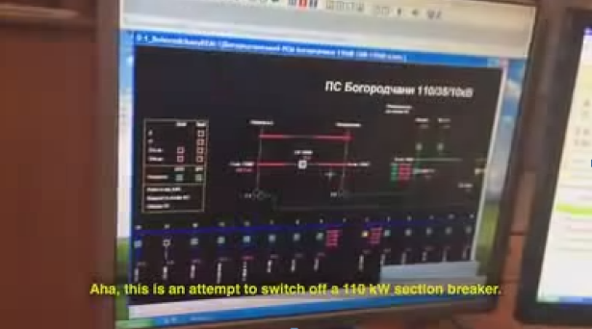

Recent Cybersecurity Incidents
Ukraine attack in 2015
  Control center was hacked
  and became malicious
CrashOverride (Industroyer)
  Reported that it was used in Ukraine attack in 2016
  Abuses widely-used ICS protocols, including IEC 104 and IEC 61850
(https://www.youtube.com/watch?v=8ThgK1WXUgk)

Slide 3
Command Authentication
Validate legitimacy of incoming control commands based on power grid status and context
Complementary to existing security solutions:
  Industrial firewall, data diode
  Intrusion / anomaly detection
  TLS (IEC 62351)
  Security measures at control center (user authentication, access control, anti-virus, etc.)

Slide 4
State-of-the-arts
Centralized approach
  Hui Lin, Adam Slagell, Zbigniew Kalbarczyk, Peter W. Sauer, and Ravishankar K. Iyer, Runtime Semantic Security Analysis to Detect and Mitigate Control-related Attacks in Power Grids, in IEEE Transactions on Smart Grid
  D. Mashima, P. Gunathilaka, and B. Chen, “Artificial command delaying for secure substation remote control: Design and implementation,” to appear in IEEE Transactions on Smart Grid.
Decentralized approach
  S. Meliopoulos, G. Cokkinides, R. Fan, L. Sun, and B. Cui, “Command authentication via faster than real time simulation,” in Power and Energy Society General Meeting (PESGM), 2016. IEEE, 2016, pp. 1–5.

Slide 5
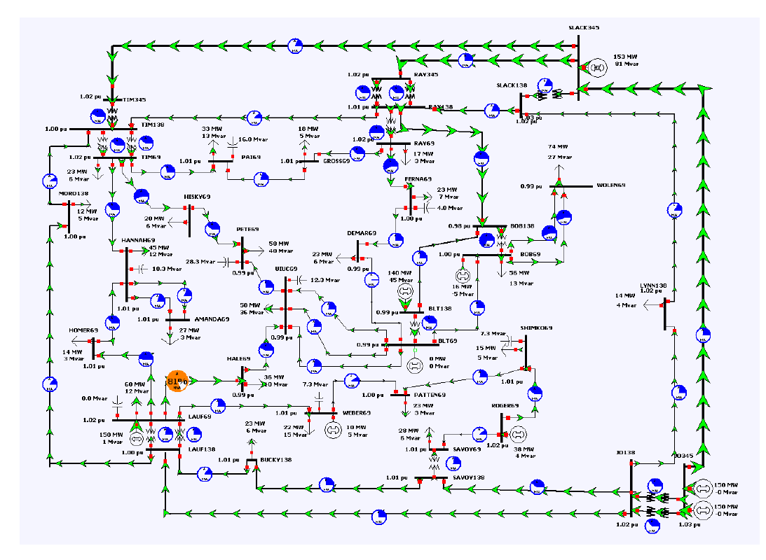
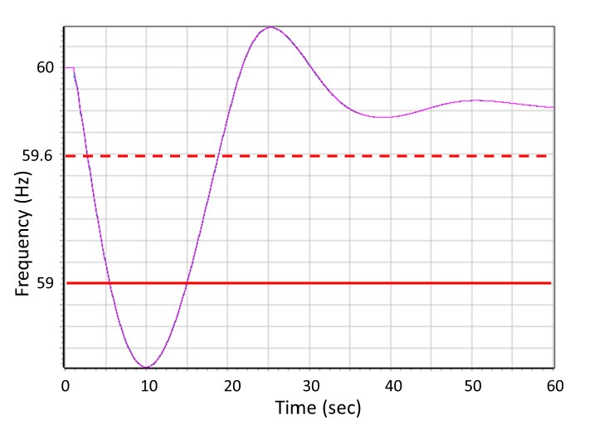
Steady-state Power Flow Simulation
Fast to calculate, good for real-time operation
But has potential limitation
Frequency violation in term of WECC Category C limit
(59Hz over 7 second)

Slide 6
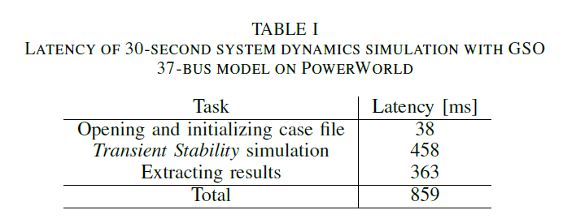
Power System Dynamics Simulation
Can simulate behavior in transient state as well as cascading failure
  Transmission line overload
  Out-of-sync generators
As expected, takes time longer time to run simulation and evaluation

Slide 7
Command Authentication Based on Power System Dynamics Simulation
For each command of interest, run 2 simulations:
  One without command execution (Res0)
  The other with command execution(Rescmd)
Compare Res0 and Rescmd to make a decision
  Any (additional) stability violation?
  Dynamics simulation was aborted? (i.e., islanding?)
  Duration till islanding
  Magnitude of frequency/voltage/power flow violation

Slide 8
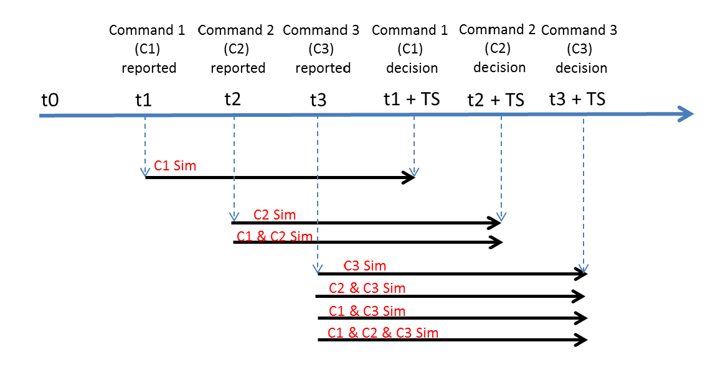
Execution Example with 3 Commnds
Power grid mode for simulation is updated.
2 simulations with and without C1 execution are run in parallel
4 simulations ({no cmd, C2 only}, {C1 only, C1+C2}) are started in parallel
Decision on C2 also depends on the decision on C1

Slide 9
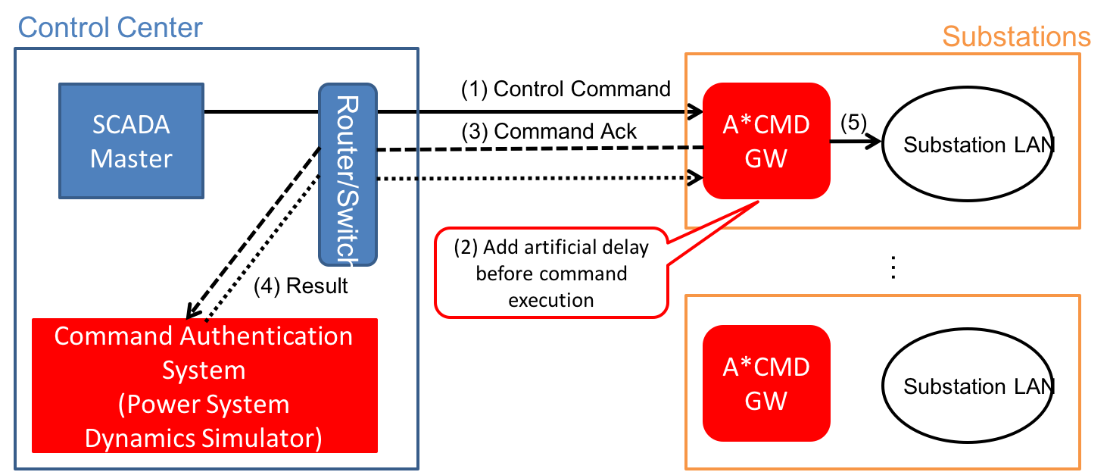
Architecture Consideration
A*CMD (Active Command Mediation Defense) with artificial command-delaying [*]
  Can delay command probabilistically or in a selective way
Run command authentication system in a centralized manner
[*] Daisuke Mashima, Prageeth Gunathilaka, and Binbin Chen, "Artificial Command Delaying for Secure Substation Remote Control: Design and Implementation." In press for IEEE Transactions on Smart Grid.

Slide 10
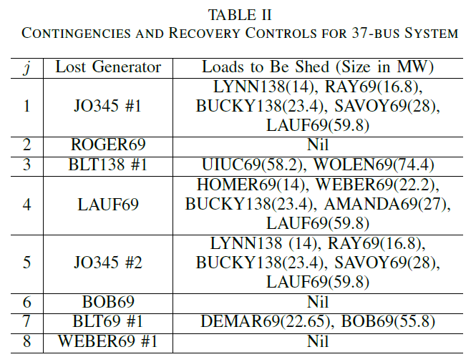
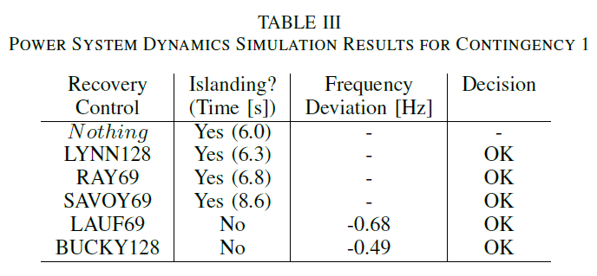
False Positives / Negatives
For N-1 generator-loss contingencies, define legitimate recovery commands
Execute command authentication to evaluate false positive
No false positive was observed
False negative may occur when malicious commands does not make the situation worse

Slide 11
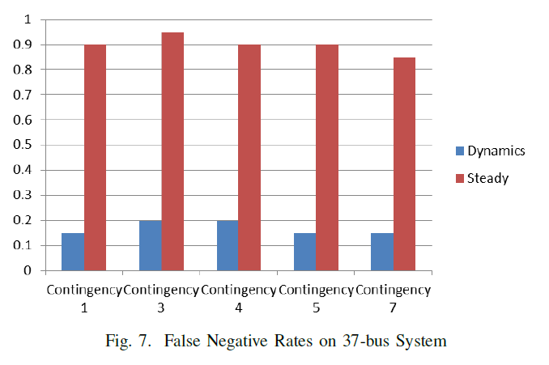
Comparison with Steady-state based Approach
Assume the load shedding controls listed in the table are the legitimate
Randomly injected other control commands (e.g., commands to open irrelevant circuit breakers and transformers)
  Considered as malicious / anomalous control commands
Evaluated whether they are flagged by each scheme

Slide 12
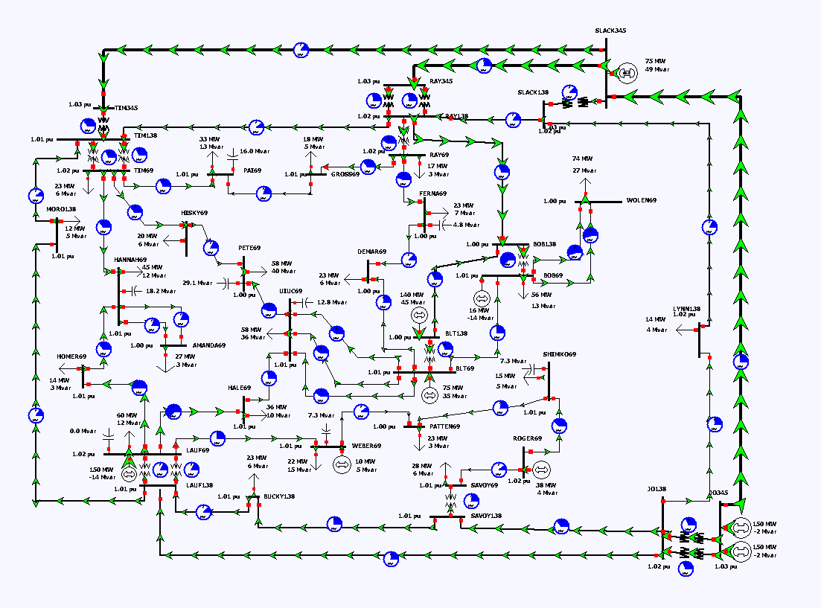
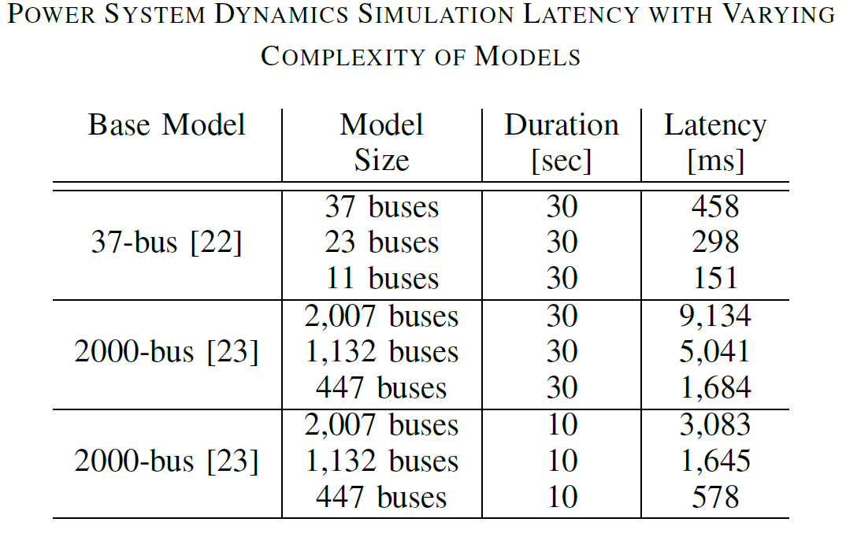
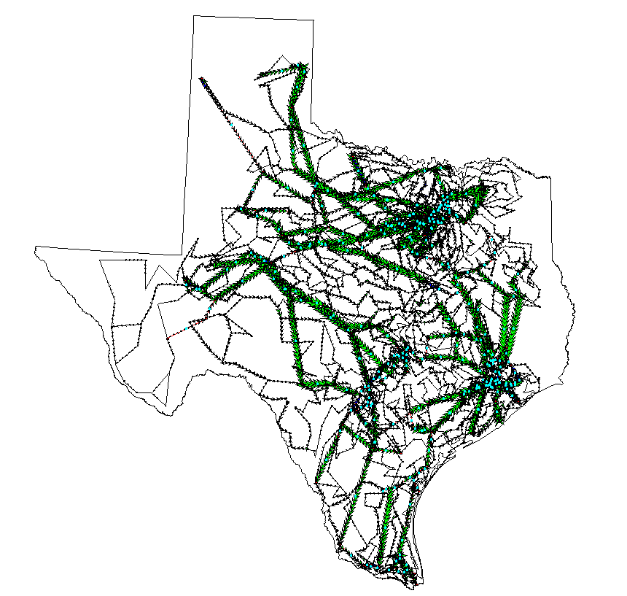
Preliminary Measurements with Larger Power Grid Model

Slide 13
Conclusions
Use of power system dynamics simulation can be a good addition for securing remote control infrastructure of smart grid.
Longer latency should be taken care of for practical operation (Integration to A*CMD was discussed).
Latency required can be too long depending on model size and complexity. Exploring tradeoff between simulation fidelity and performance is an interesting future work.

Slide 14
Thank you very much!
Questions?
  Email: daisuke.m@adsc-create.edu.sg
We are hiring full-time researchers for the government-funded smart grid security & resilience research projects in Singapore.
  For details, please feel free to contact me or refer to http://www.mashima.us/daisuke/files/adsc-hiring.pdf

