Slide 1
SoftGrid: A Software-based Smart Grid Testbed for Evaluating Substation Cybersecurity Solutions
Prageeth Gunathilaka
Daisuke Mashima
Binbin Chen
Acknowledgment:
The work was in part funded under the Energy Innovation Research Programme (EIRP, Award No. NRF2014EWT-EIRP002-040), administrated by the Energy Market Authority (EMA) and in part by the research grant for the Human-Centered Cyber-physical Systems Programme at the Advanced Digital Sciences Center from Singapore’s Agency for Science, Technology and Research (A*STAR). The EIRP is a competitive grant call initiative driven by the Energy Innovation Programme Office, and funded by the National Research Foundation (NRF).

Slide 2
Outline
Motivation
SoftGrid Design and Implementation
Case Study
How it Works
Conclusions

Slide 3

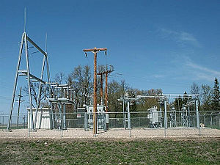

Electrical Substations
A substation is a crucial component of an power grid system connecting generation and loads
Substations transform voltage from high to low, or the reverse, or perform any of several other important functions.
Between the generating station and consumer, electric power may flow through several substations at different voltage levels.
Over 10,000 transmission/distribution substations in Singapore.

Slide 4
Remote Control Use Cases
Power shedding
  To handle over-generation from renewables, the control center controls the output from the generation and/or makes it offline
Voltage regulation
  Shunt reactors/capacitors are controlled (either on/off or variable setpoints) to manage voltages according to the change in loads
Topology control
  To optimize generation and transmission cost, power grid topology is changed.

Slide 5

Security Risks
Attack from network
  Insecure deployment of IEC 60870 and 61850 is vulnerable against man-in-the-middle attacks, replay attacks, etc.
    B. Kang, P. Maynard, K. McLaughlin, S. Sezer, F. Andren, C. Seitl, F. Kupzog, and T. Strasser. Investigating cyber-physical attacks against iec 61850 photovoltaic inverter installations. In Emerging Technologies & Factory Automation (ETFA), 2015 IEEE 20th Conference on, pages 1–8. IEEE, 2015.
    P. Maynard, K. McLaughlin, and B. Haberler. Towards understanding man-in-the-middle attacks on iec 60870-5-104 scada networks. In Proceedings of the 2nd International Symposium on ICS & SCADA Cyber Security Research 2014, pages 30–42. BCS, 2014.
Attack from the control center
  Disgruntled insiders
  Malware
  Physical / Cyber intruders

Slide 6
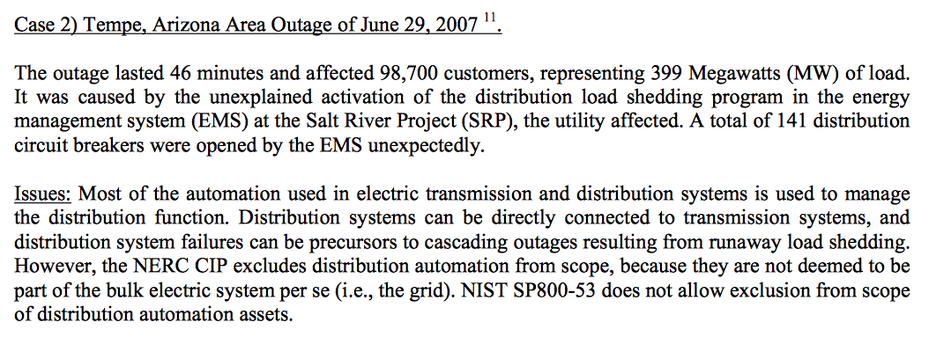
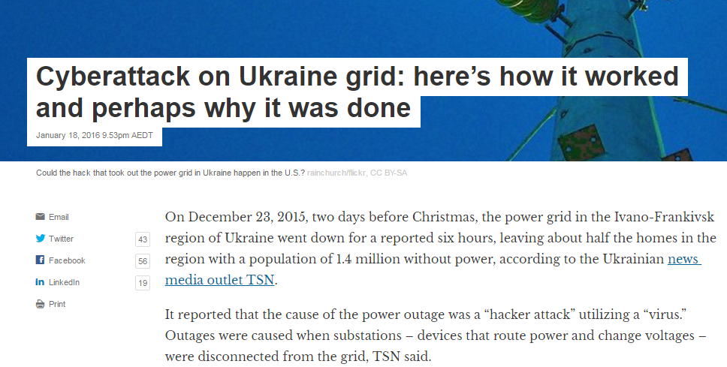
Threats Are Real!
http://realtimeacs.com/wp-content/downloads/pdfs/House-Hearing-10-17-Final.pdf
http://theconversation.com/cyberattack-on-ukraine-grid-heres-how-it-worked-and-perhaps-why-it-was-done-52802
Trust assumption on the control center is no longer valid.
We need additional layer(s) of security to minimize physical impact of cyber attacks!

Slide 7
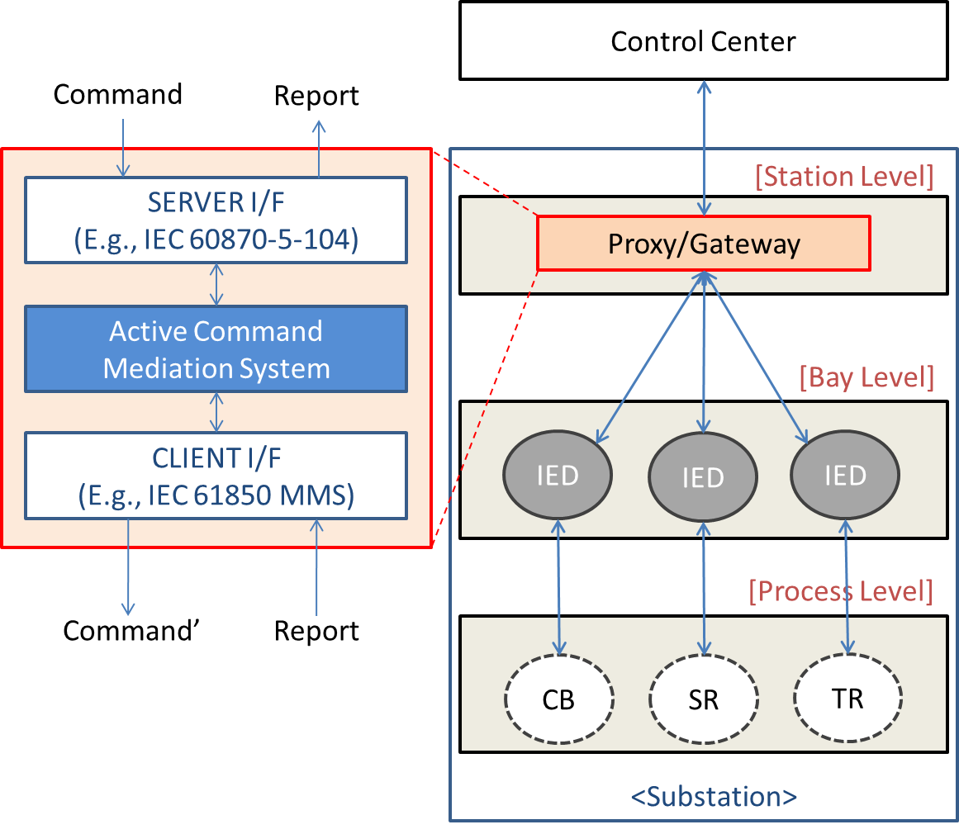
Solutions for Securing Electrical Substations
Industrial Firewall
  Tofino Firewall
Intrusion Detection Systems
  Bro supporting DNP3 and/or IEC60870-5-104 protocols
Security-enhanced Substation Gateway
  Active Command Mediation Defence System (A*CMD)
  Rate limiting etc.
Daisuke Mashima, Prageeth Gunathilaka, and Binbin Chen, "An Active Command Mediation Approach for Securing Remote Control Interface of Substations."
To appear at IEEE SmartGridComm 2016 in November, 2016.

Slide 8
Testing Environment is Desired
For Security Researchers and Engineers
  Simulate cyber attacks to evaluate effectiveness
  Tune configuration of security solutions
For Grid Operators
  Check compatibility with existing infrastructure
  Evaluate performance and throughput

Slide 9
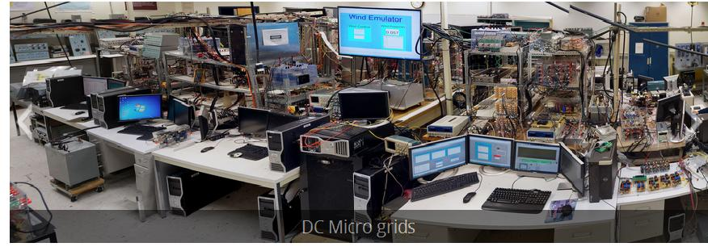
Existing Smart Grid / CPS Testbeds (1)
Hardware-based testbed
  High fidelity thanks to use of real physical devices
  Lacks accessibility, flexibility, and scalability
  Non-negligible introductory and running cost
(http://sgc2015.ieee-smartgridcomm.org/content/2015-patrons-and-demos)

Slide 10
Existing Smart Grid / CPS Testbeds (2)
Software-based Smart Grid / CPS Testbeds
  Score and Scoreplus by Tan et al.
    Not specifically designed for cybersecurity evaluation
  Smart Grid Testbed by Genge et al. (ISGT EU 2011)
    Emulate cyber-side by Emulab, which is connected to simulated physical system on Matlab SimuLink
    Not support protocols commonly used in modernized substations (IEC 60870-5-104, IEC 61850)
  AMICI, EPIC by Genge et al.
    Support a variety of attack vectors, such as PLC compromise
    Designed for generic CPS (e.g., railway systems), and therefore lacks some features specific to smart power grid context we desire

Slide 11
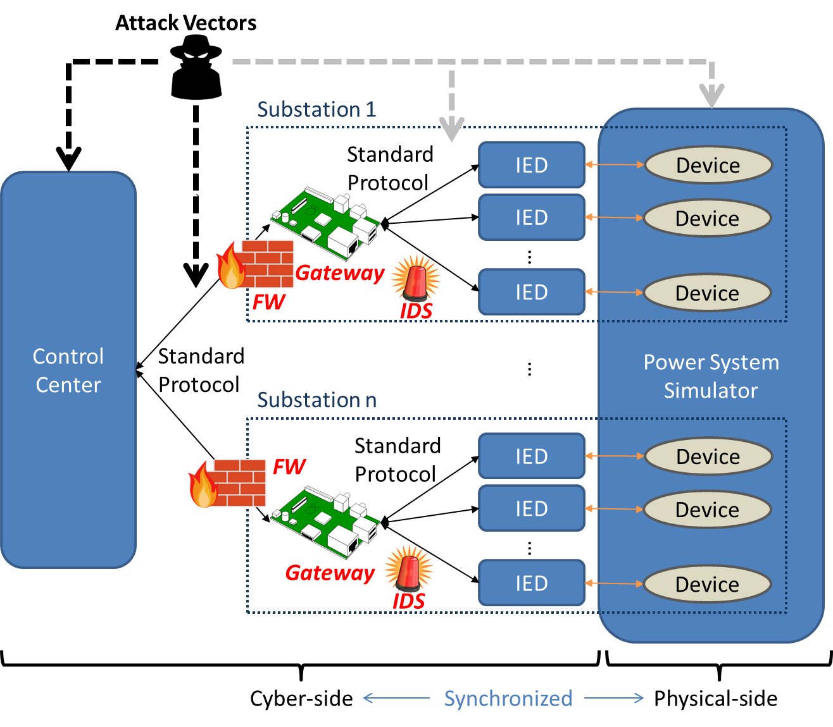
Design Goals
Portable, flexible, and scalable
  Standard-compliant Control Center and IED
  Software-based power grid simulation
  Cyber-physical synchronization
  Usable monitoring GUI
  Turn-key solution

Slide 12
Implementation Approach
Use of OpenMUC for supporting standard protocols (IEC 60870-5-104, 61850) for control center and IEDs
Use of PowerWorld for configurable, scalable power grid simulation
Real-time cyber-physical interaction with PowerWorld COM API
Logging and monitoring of power grid status, including transient stability, and tools for facilitating evaluation
Automated generation of IEC 61850 SCL files based on PowerWorld case file for quick system set up

Slide 13
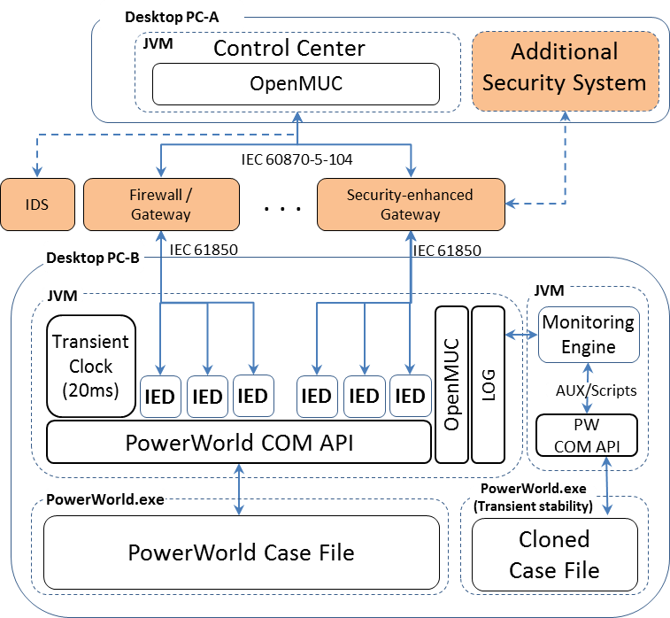
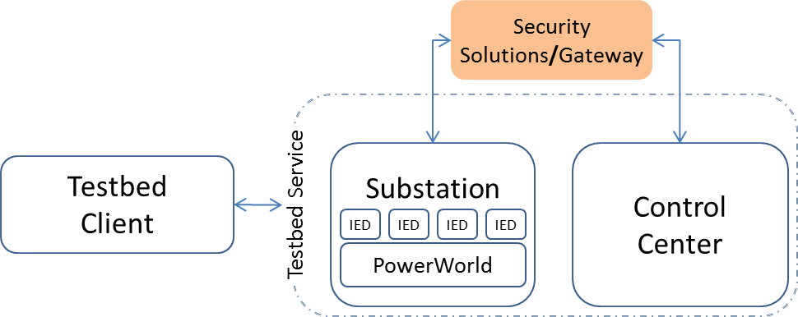
SoftGrid System Architecture
Testbed Client can facilitate execution and management of experiments by offering centralized control of SoftGrid components.

Slide 14
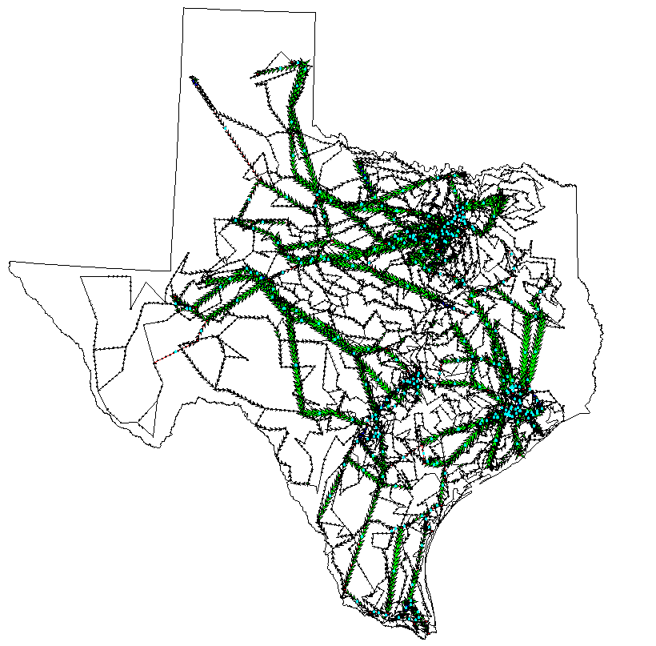
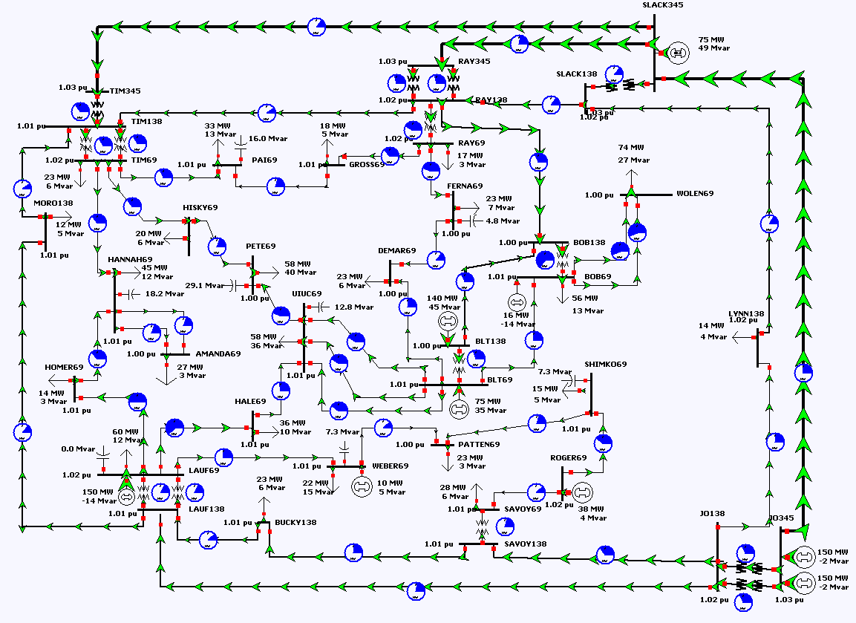
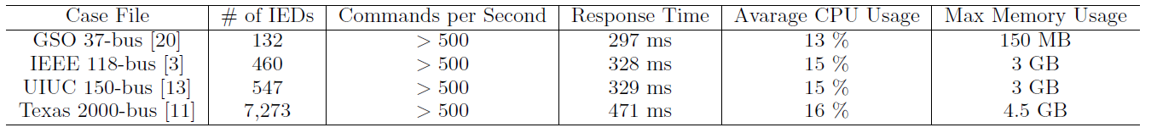
SoftGrid Scalability
Tested with power grids up to 2000-bus systems

Slide 15
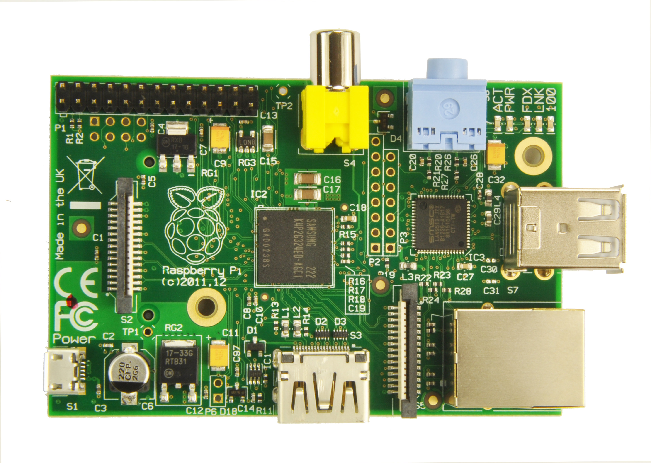
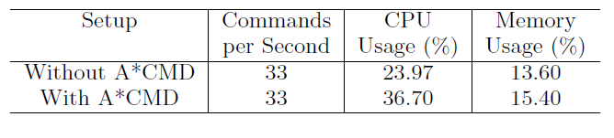
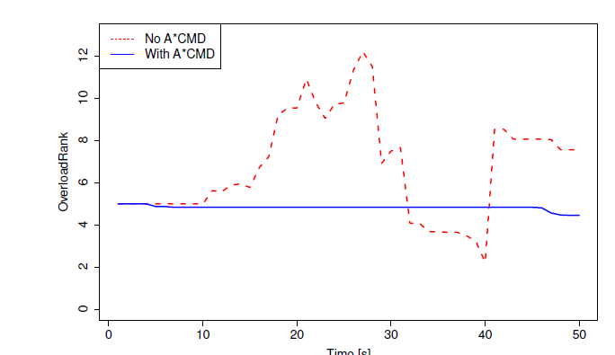
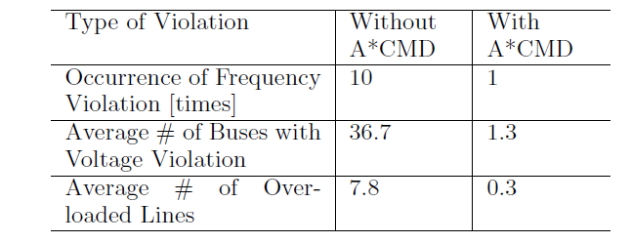
Case Study: Evaluating A*CMD Prototype
Stress testing
Mitigation of attack impacts
Implemented on Raspberry Pi

Slide 16
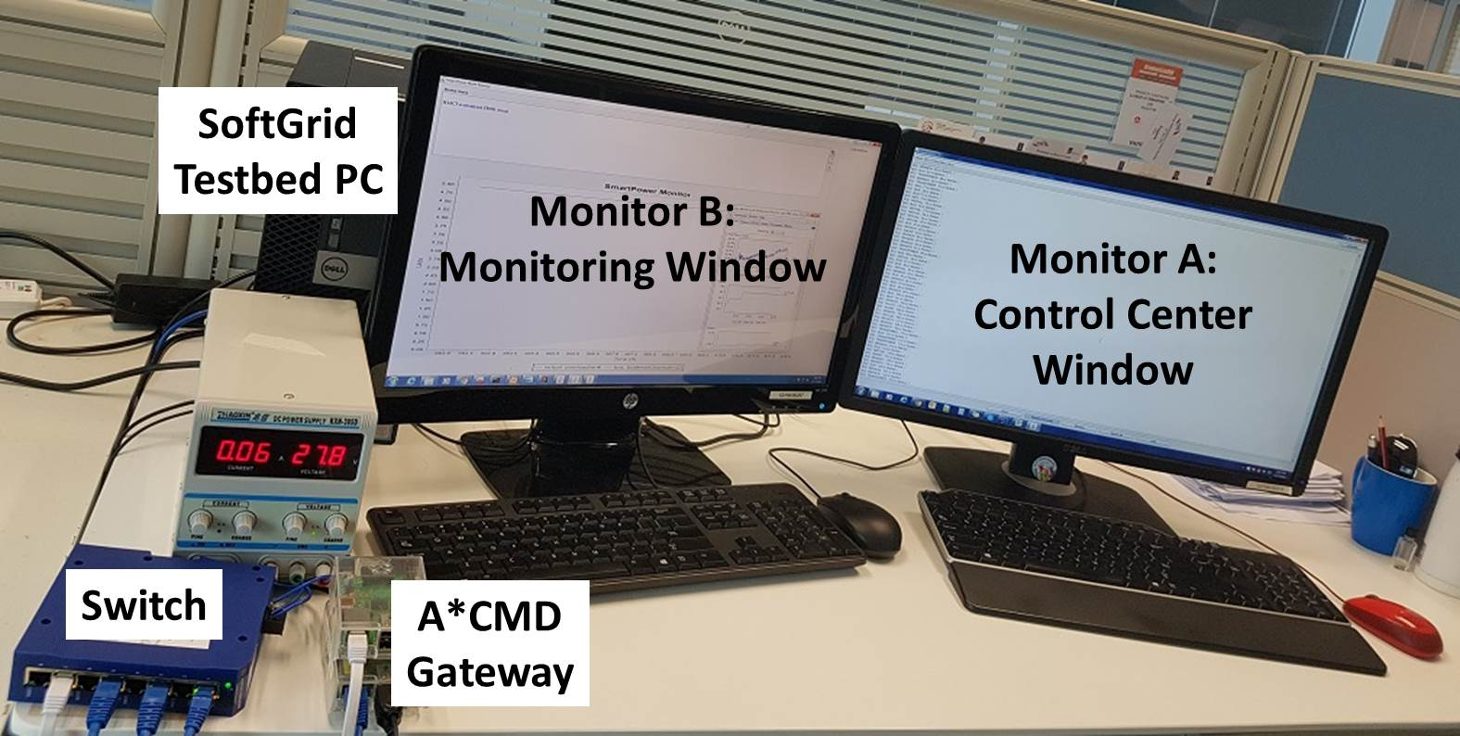
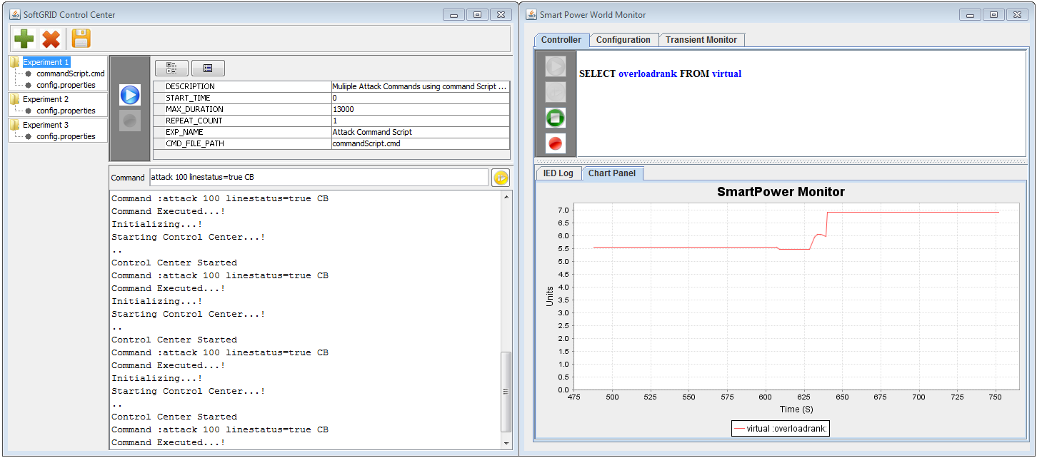
How SoftGrid Works

Slide 17
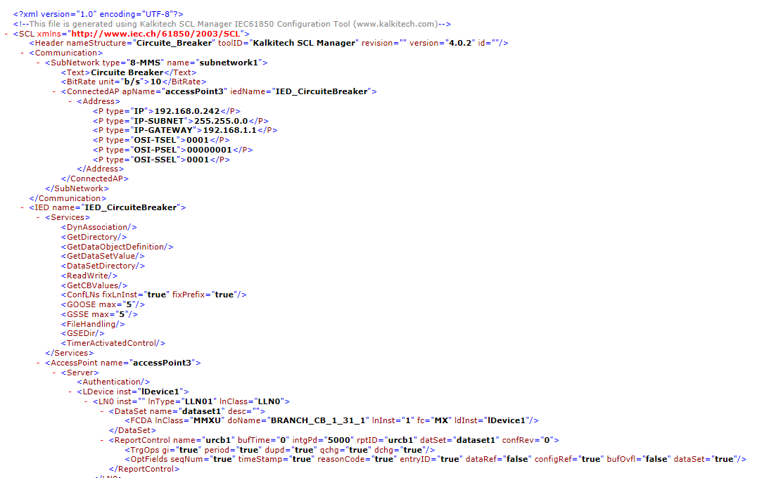
Automated IEC 60870/61850 Setup
(1) Design PowerWorld case file
(2) IEC 61850 SCL files are generated
for each IED

Slide 18
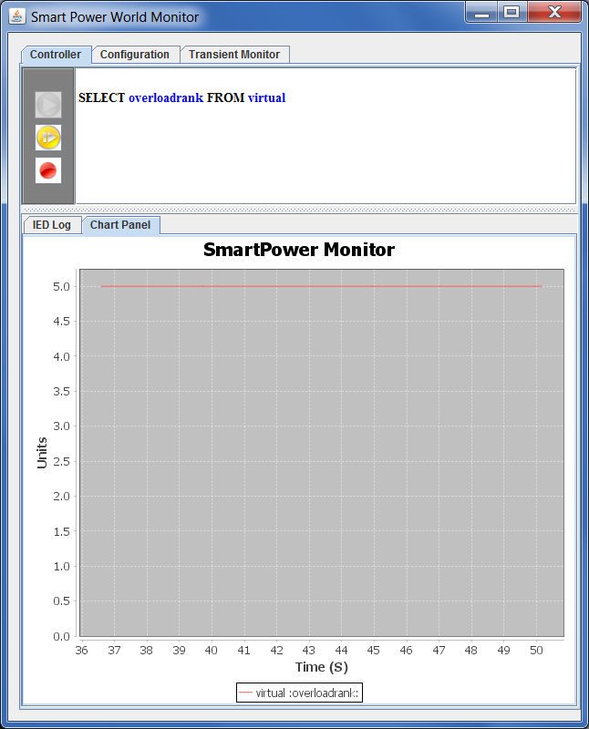
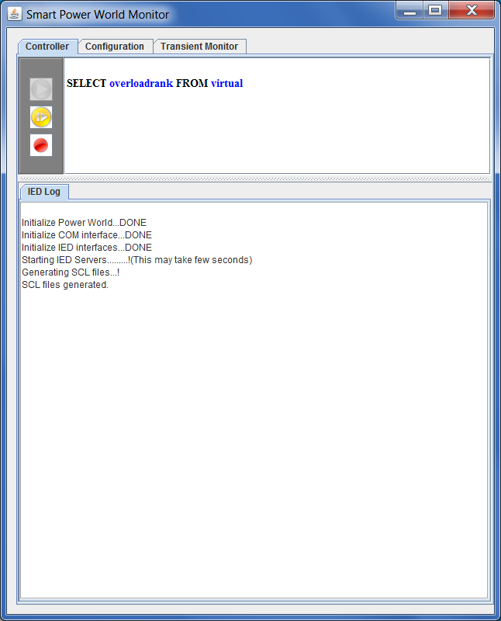
Starting IEDs
GUI for monitoring power grid status opens
Behind the scene, all IEDs are started according to SCLs.

Slide 19
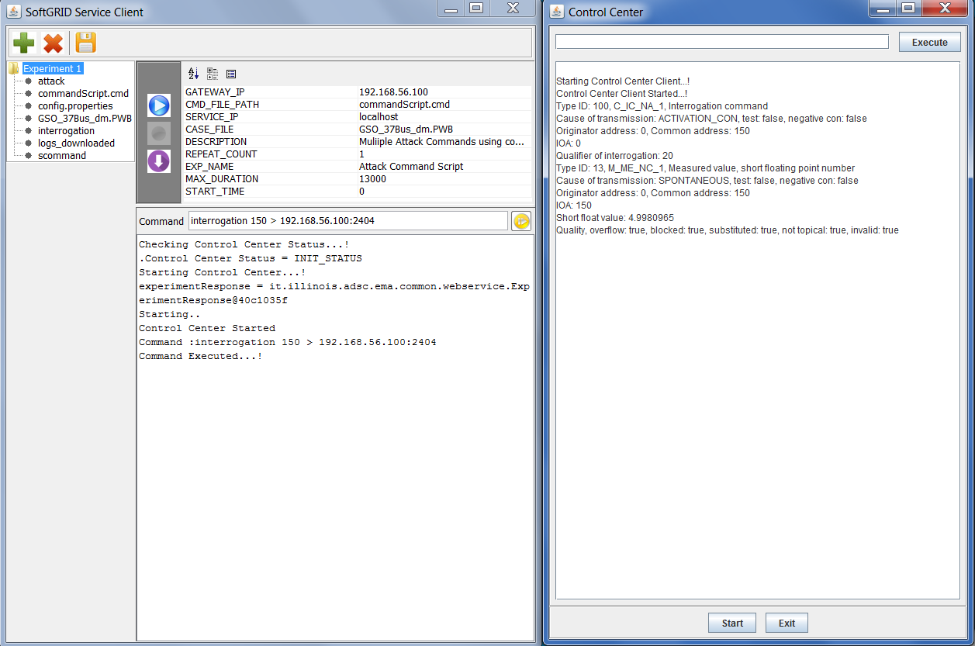
Starting Testbed Client / Control Center
On another JVM, Testbed Client (TC) is started.
TC creates Control Center instance and operates it via Web Service.

Slide 20
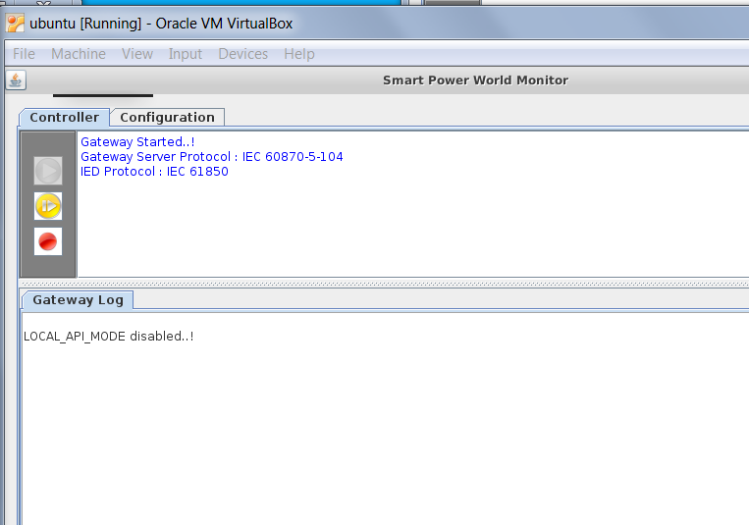
Protocol Translation Gateway
SoftGrid also contains simple protocol translation gateway implementation
  IEC 60870-5-104
  IEC 61850
Can be configured by generated SCL files

Slide 21

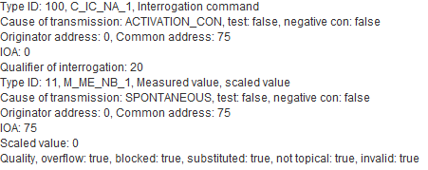
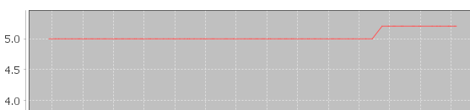
Sending Commands
(1) Interrogation command
(2) Response from the IED is shown on Control Center Window
(3) Control command (open a circuit breaker)
(4) Change in grid status is also visible on IED Monitoring Window

Slide 22
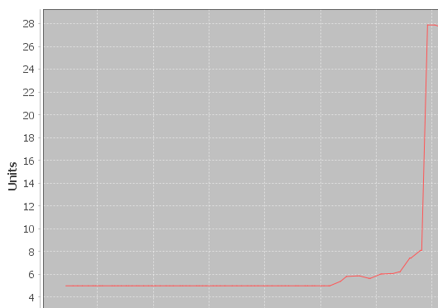
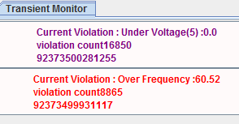
Attack Experiment
(1) Commencing attacks (opening 50% of randomly selected circuit breakers)
(2) Evaluation of attach impact

Slide 23
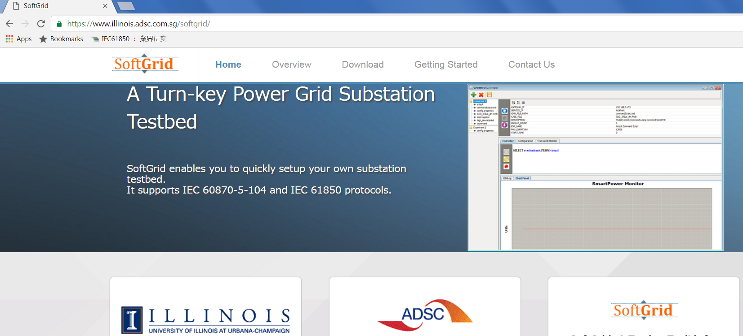
Open Source
SoftGrid is an open source project.
  Requirements: JDK1.8, Python 2.7, and PowerWorld
  For further details and updates, stay tuned at https://www.illinois.adsc.com.sg/softgrid/

Slide 24
Conclusions
SoftGrid is a portable, flexible, scalable, turn-key testing toolkit for substation cybersecurity solutions.
SoftGrid is an open-source project.
Future directions:
  Support of other control protocols, e.g., DNP3
  Integration of virtual network systems, e.g., Mininet, Emulab
  Enhancement of attack vectors
  Support of other power flow simulators

Slide 25
Thank you very much!
SoftGrid Web Site:
  https://www.illinois.adsc.com.sg/softgrid/
Questions and Comments:
  softgrid@adsc.com.sg

