Slide 1
Enhancing Demand Response Signal Verification in Automated Demand Response Systems
Daisuke Mashima, Ulrich Herberg, and Wei-Peng Chen
SEDN (Solutions for Electricity Distribution Networks) Group
Fujitsu Laboratories of America, Inc.

Slide 2

What is OpenADR?
Internationally-recognized, and the most widely adopted standard for automated demand response
Defined as a subset of OASIS Energy Interoperation version 1.0
The latest 2.0 b profile was released in August, 2013.

Slide 3
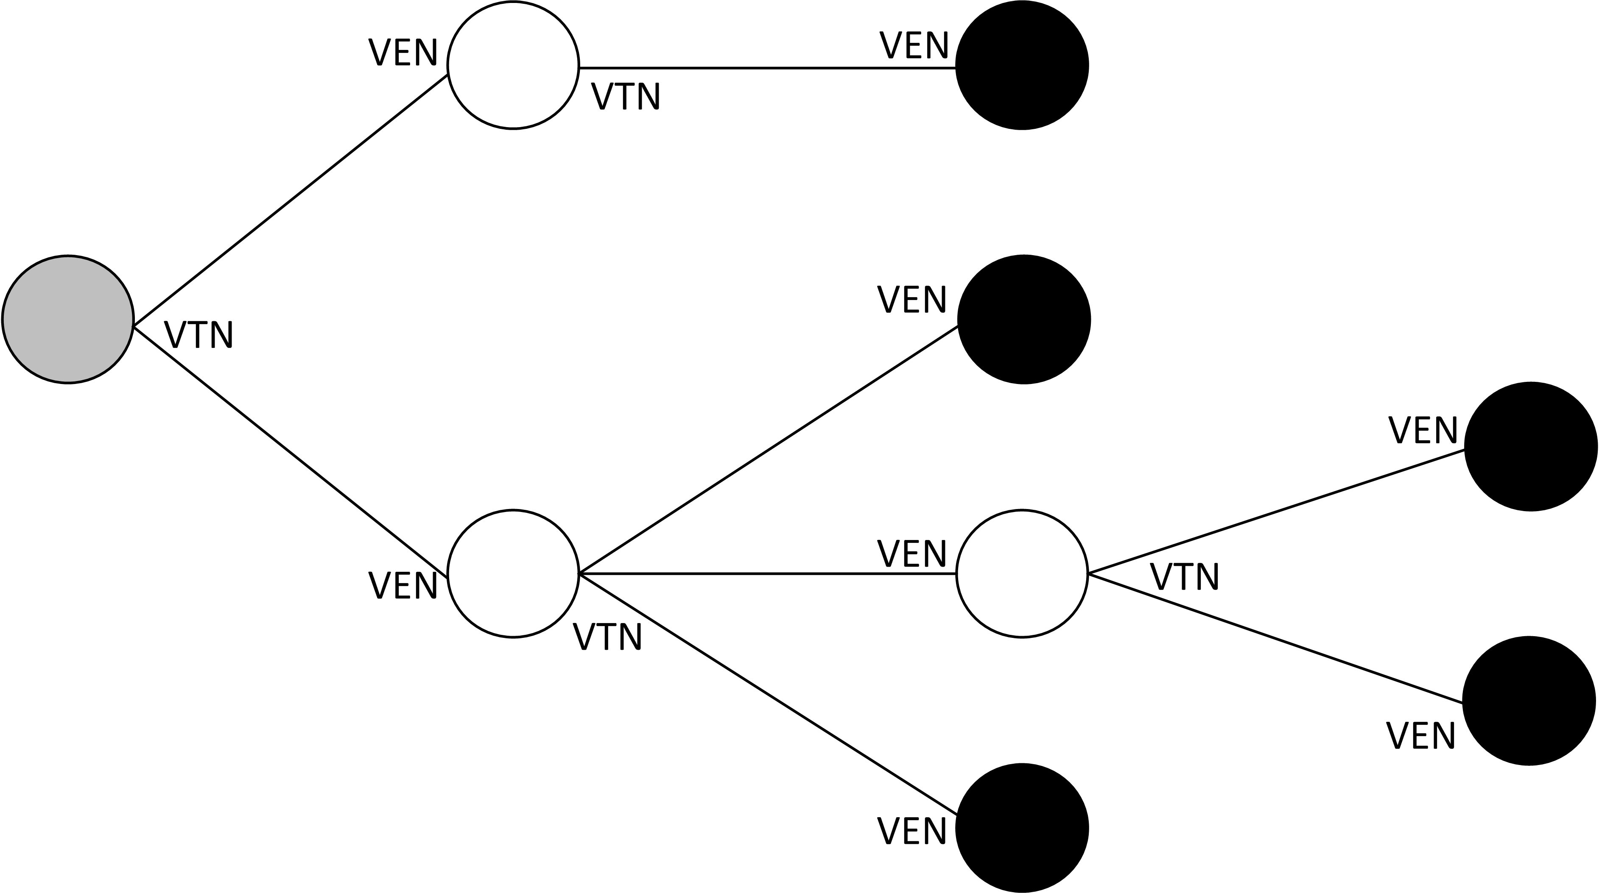
OpenADR Communication Model
Communication nodes are organized as a tree
HTTP and XMPP as transport mechanisms
DR Aggregator
Utility/
ISO/RTO
HEMS,
Thermostat,
Smart Appliance etc.
Top-most
VTN
BEMS
Intermediary
Virtual End Node (VEN): DR Client
Virtual Top Node (VTN): DR Server
End-most
VEN

Slide 4

Security in OpenADR
Mandates use of TLS with client authentication
  All nodes are equipped with a key pair and certificate
  Message (e.g., DR event signal) integrity and confidentiality
  Mutual Authentication
Optionally supports XML Signature for non-repudiation
Sufficient for establishing one-hop security, but…

Slide 5
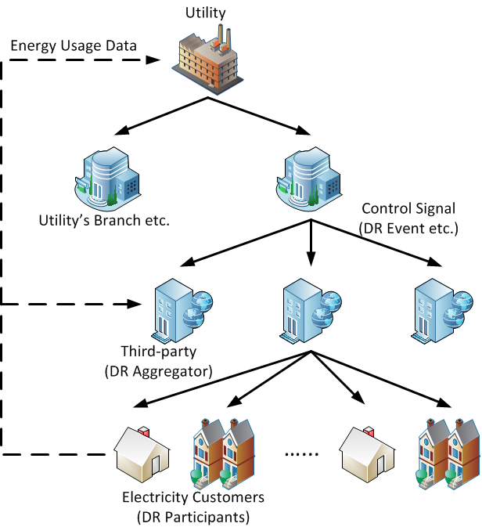

Problem in Multi-hop DR Communication
What happens if intermediary is compromised or misbehaving?
How can downstream entities detect the problem/attack?
Impact of malicious DR signal could be broad!

Slide 6
Proposed Solution
Provide end-most VENs with verifiable information to make informed decision
  Entities involved in DR signal distribution path
  Contents of the DR signal issued by the top-most VTN.
Does not violate OpenADR 2.0 specification
  In OpenADR 2.0b schema, eiEvent:eventDescriptor:vtnComment can accommodate arbitrary text data, under which we can embed additional data.

Slide 7

Verifiable DR Signal Distribution Path
Implemented as the chain of digital signatures
T’s DR Signal
Top-most
VTN (T)
A’s DR Signal
Compared to
evaluate consistency
P1=[M, A]T
Metadata that uniquely identifies the DR Signal
A
B’s DR Signal
P2=[P1, B]A
B
E verifies P1, P2, and P3 in order, which establishes verifiable path.
- Verification of P1: T → A
- Verification of P2 : T → A → B
P3=[P2, E]B
End-most
VEN (E)

Slide 8
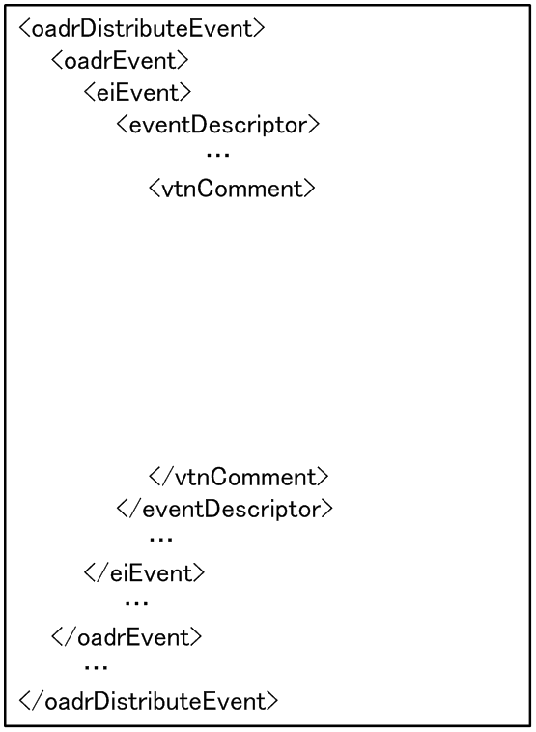
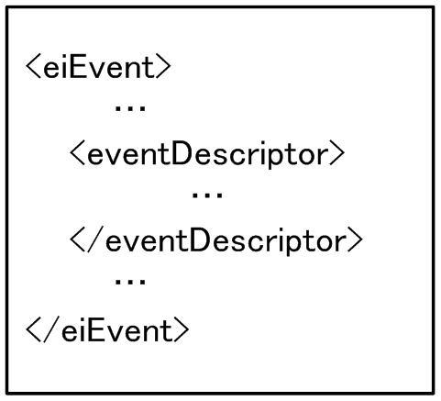
Implementation – Top-most VTN
Compressed with EXI
(Efficient XML Interchange)
Then encoded by Base64
EXI-encoded eiEvent
Recipient ID (ID1)
Signature (P1)
Metadata M is calculated
based on the original message or EXI-encoded message, which is then signed with the recipient ID

Slide 9
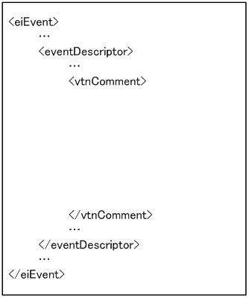
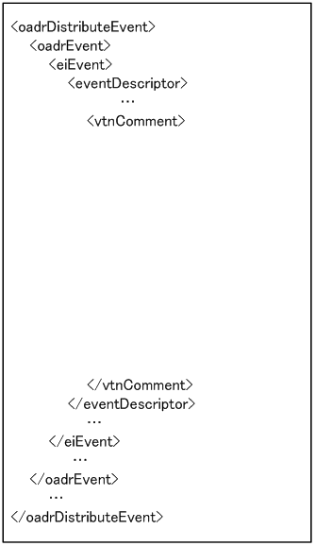
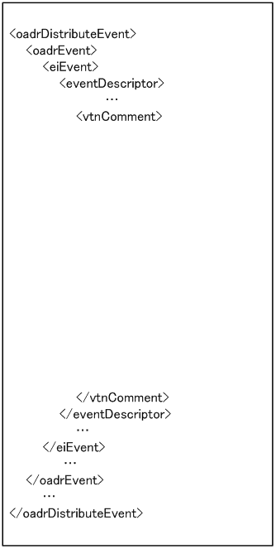
Implementation – Intermediary
Intermediary generates
its own DR signal based on
the one from the upstream
Other intermediaries processes similarly
DR signal from
Top-most VTN
DRtop
Copy
DRtop
DRtop
ID1
ID1
ID1
P1
P1
Copy
P1
ID2
ID2
P2
P2
ID3
P3

Slide 10
Extension for Privacy
DR signal issued by the top-most VTN may contain information that end-most VEN does not “need to know”.
It is desired to allow intermediaries to appropriately hide some portion of the top-most VTN’s DR event signal, without invalidating the discussed schema.
Redactable signature scheme to create M and P1
  Implemented Merkle Hash Tree based scheme
  Please refer to the paper for more detail.

Slide 11

Performance Summary
Setting for measurements:
  Laptop with Intel Core i7 processor and 8GB RAM
  2048-bit RSA and SHA256
Processing time (average of 10 executions)
  Top-most VTN: 23.4ms
  Intermediary: 22.7ms
  Verification at end-most VEN: 15ms
Message size overhead
  50-60% of the original eiEvent
  300-400 Byte per hop

Slide 12
Conclusions
Implemented extended DR event signal verification under OpenADR specification
  Verifiable DR signal distribution path
  Verification of semantic consistency of DR signals
  Can be integrated into existing OpenADR systems
Future Direction
  Improve the scheme for lower overheads
  Proposal to OpenADR Alliance

Slide 13

Thanks!
Please direct your questions and comments to:
dmashima@us.fujitsu.com

